Slide 1
Migration Analysis

Slide 2
Discretization of variables

Slide 3
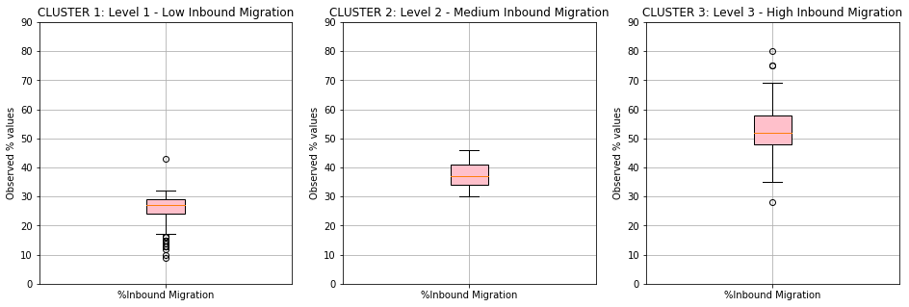
%Inbound Migration
Variable | Parameter | Label 1 (low) | Label 2 (medium) | Label 3 (high)
Inbound Migration | %Inbound Migrants | 17-32 | 32-46 | 46-69

Slide 4
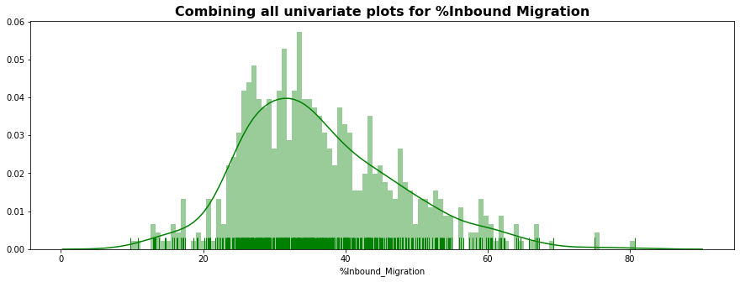
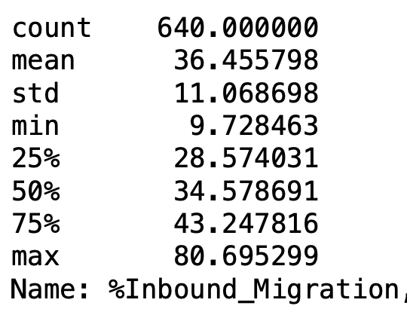
We get 160 districts in the top 25% or 75th percentile.

Slide 5
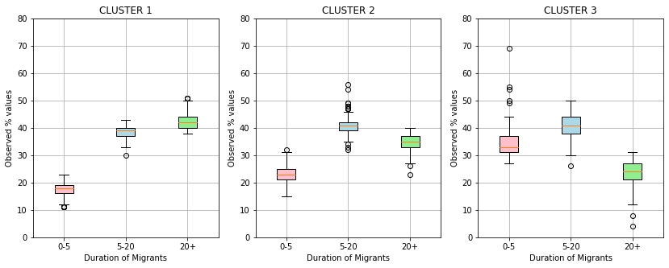
2. Duration (Clustering on 0-5/5-20/20+ years)
Label 1: Long term migration
Label 2: Medium term migration
Label 3: Short term migration
Variable | Parameter | Label 1 | Label 2 | Label 3
Duration | 0-5 years | 11-23 | 15-32 | 27-69
 | 5-20 years | 30-43 | 32-56 | 26-50
 | 20+ years | 38-51 | 23-40 | 4-31

Slide 6
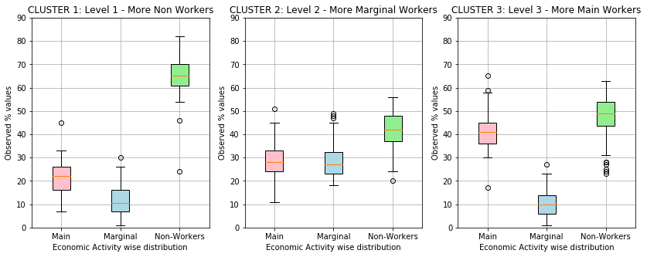
3. Type of workers
Variable | Parameters | Label-1 | Label-2 | Label-3
Type of Workers | %Main workers | 7-34 | 11-46 | 30-58
 | %Marginal Workers | 1-27 | 18-46 | 1-24
 | %Non-Workers | 54-82 | 24-56 | 31-63

Slide 7
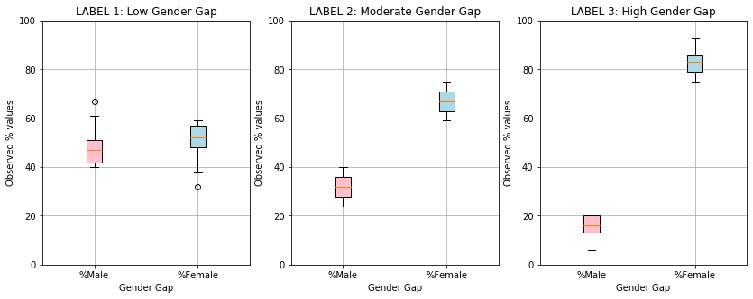
4. Gender Gap
Variable | Parameter | Label-1 | Label-2 | Label-3
Gender of migrants | %Male | 40-67 | 22-40 | 6-24
 | %Female | 32-59 | 59-75 | 75-93

Slide 8
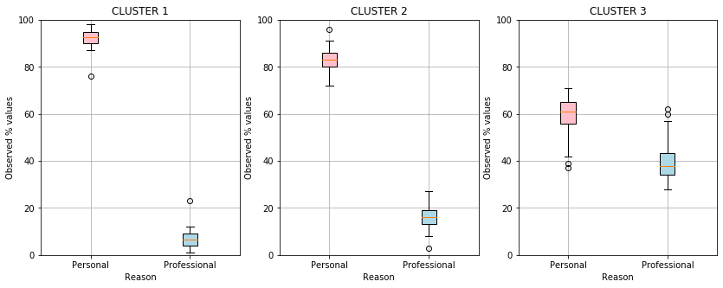
5. Personal/professional reason for migration
Label 1: Very High personal, low professional reason
Label 2: High personal, low professional reason
Label 3: Low personal, high professional reason
Variable | Parameter | Label-1 | Label-2 | Label-3
Reason Gap | %Migrants migrating for personal reason | 76-98 | 72-96 | 37-71
 | % Migrants migrating for professional reason | 1-23 | 3-27 | 28-62

Slide 9
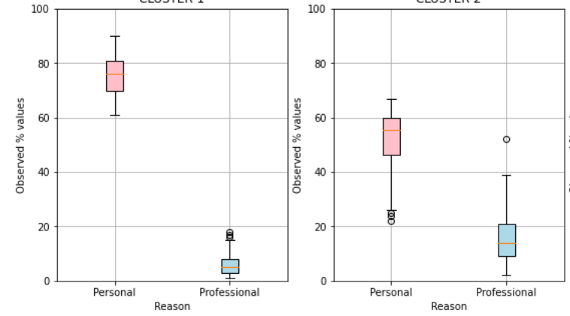
5. Personal/professional reason for migration
Label 1: Very High personal, low professional reason
Label 2: Low personal, high professional reason
Variable | Parameter | Label-1 | Label-2
Reason Gap | %Migrants migrating for personal reason | 61-90 | 21-67
 | % Migrants migrating for professional reason | 1-19 | 3-52

Slide 10
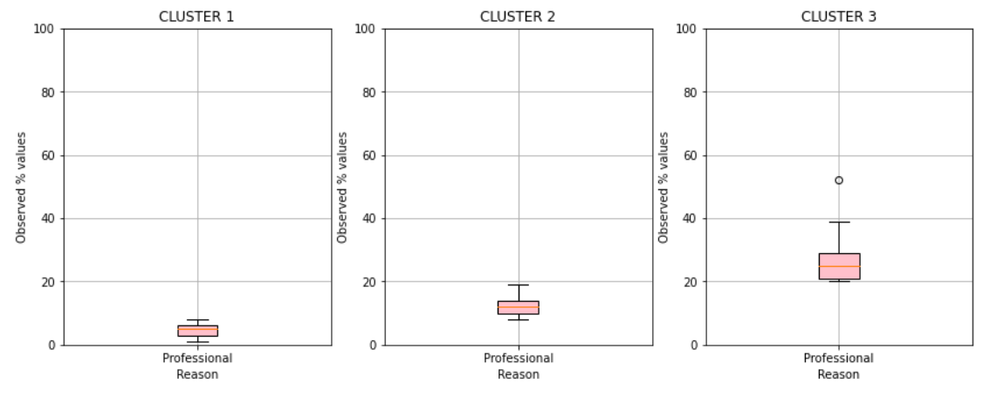
5. Professional reason for migration
Label 1: Low professional reason
Label 2: Moderately professional reason
Label 3: High professional reason
Variable | Parameter | Label-1 | Label-2 | Label-3
Reason Gap | % Migrants migrating for professional reason | 1-10 | 11-19 | 20-39
Districts | % Migrants migrating for professional reason | 410 | 173 | 57

Slide 11
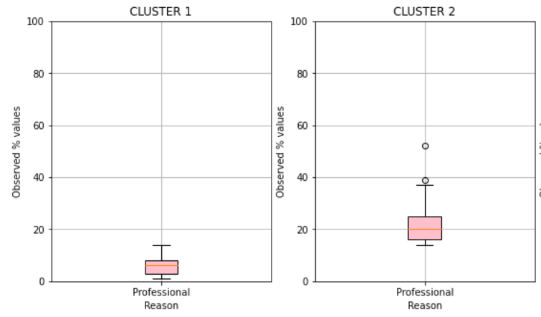
5. Professional reason for migration
Label 1: Low professional reason
Label 2: High professional reason
Variable | Parameter | Label-1 | Label-2
Reason Gap | % Migrants migrating for professional reason | 1-13 | 14-39
Districts | % Migrants migrating for professional reason | 534 | 106

Slide 12
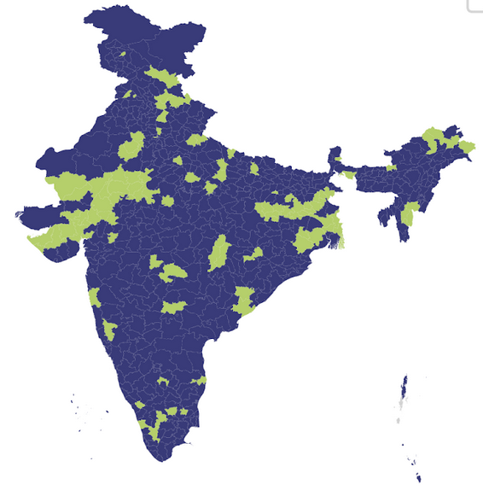
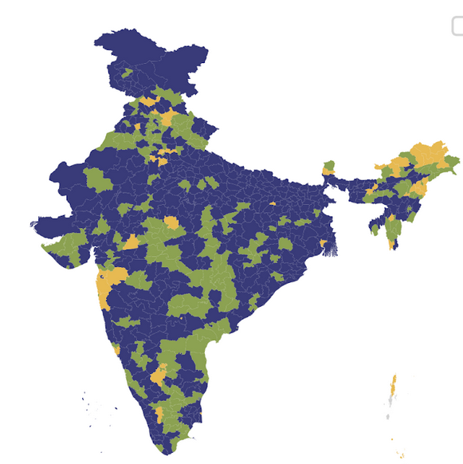
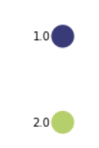

Slide 13
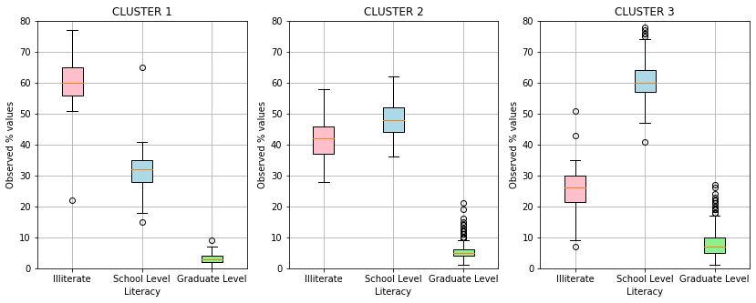
6. Literacy Gap
Label1: Illiterate dominant
Label2: Balanced Literates and Illiterates
Label3: Literate dominant
Variable | Parameter | Label-1 | Label-2 | Label-3
Literacy Gap | % Illiterate migrants | 22-77 | 28-58 | 7-51
 | % School-level literate migrants | 15-65 | 36-62 | 41-83
 | % Graduate-level literate migrants | 0-9 | 1-21 | 1-27

Slide 14
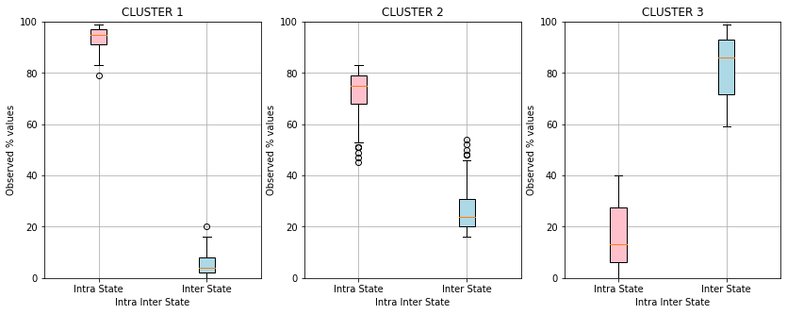
7. Intra-Inter State Migration
Label 1:Intra State Dominant Migration
Label 2: Lower Inter-State, High Intra State migration
Label 3:Inter State Dominant Migration
Variable | Parameter | Label-1 | Label-2 | Label-3
Intra/Inter State Migration Gap | % Intra-state migrants | 79-99 | 45-83 | 0-40
 | % Inter-state migrants | 0-20 | 16-54 | 59-99

Slide 15
Map Visualization of different migration-based indicators

Slide 16
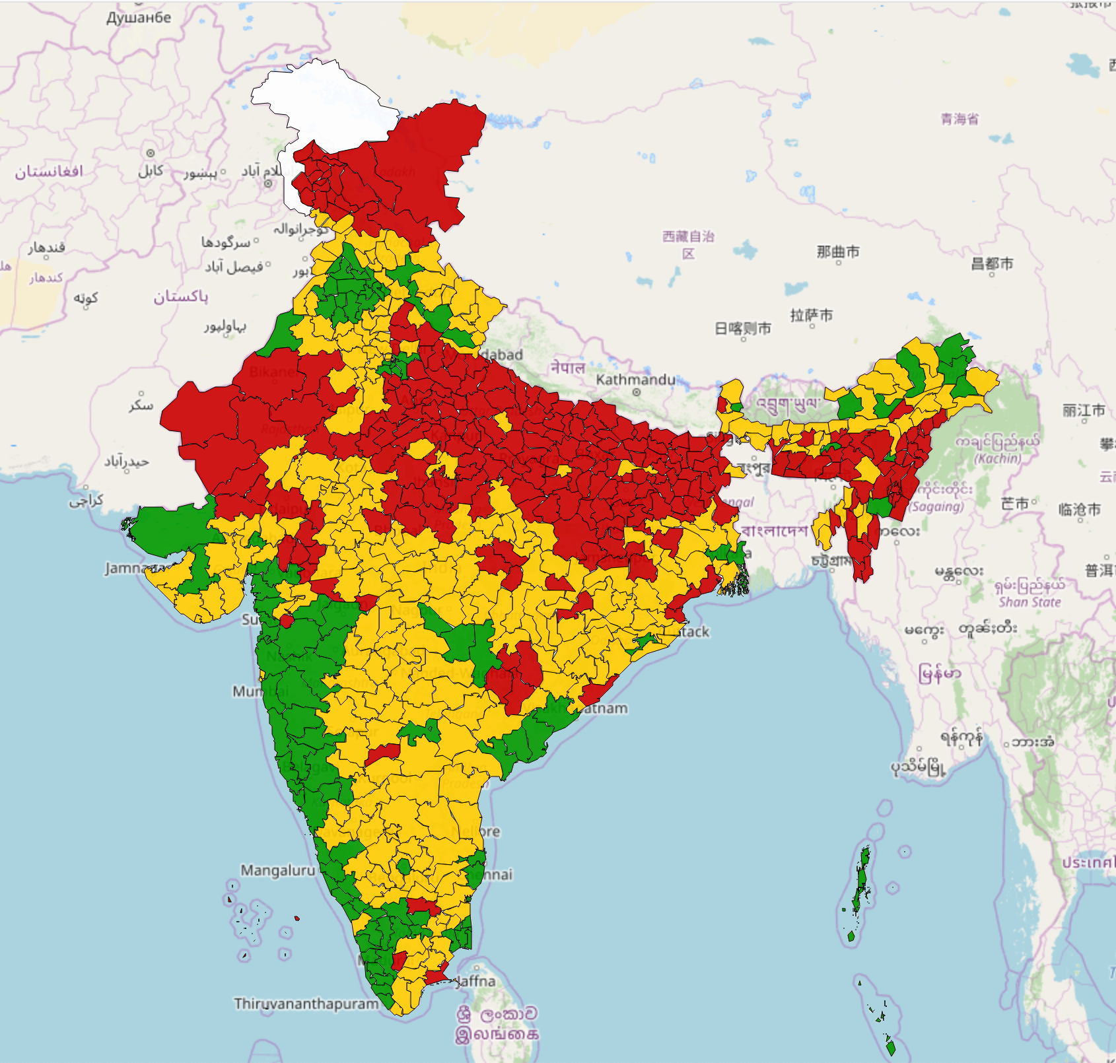
INBOUND MIGRATION
 | Low Inbound
 | Medium Inbound
 | High Inbound
 | No Data
Majority of north India has low inbound migration
Western and southern-western parts of India have high inbound migration

Slide 17
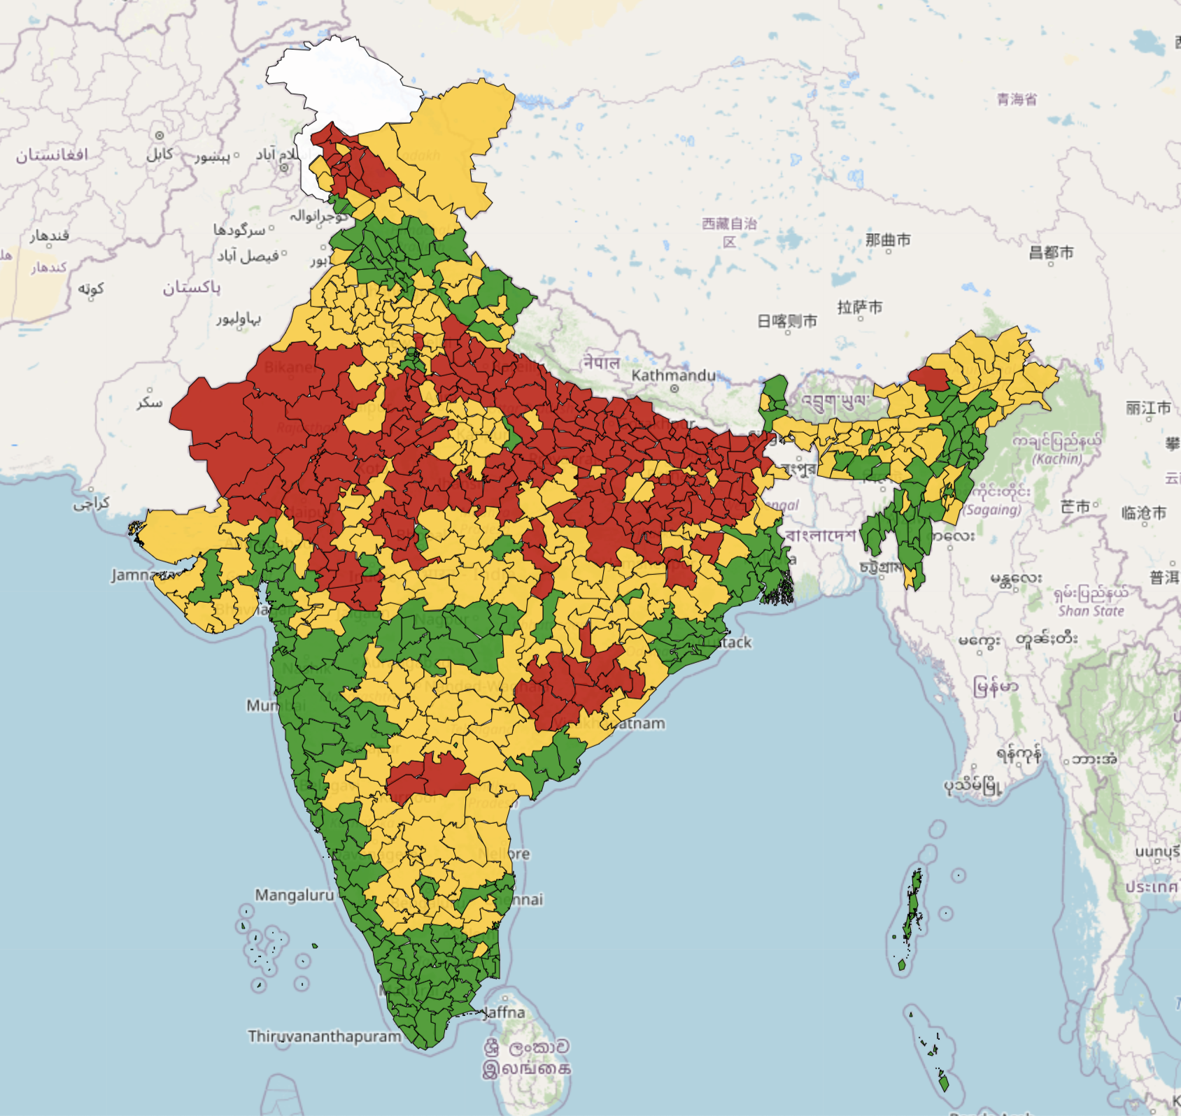

Slide 18
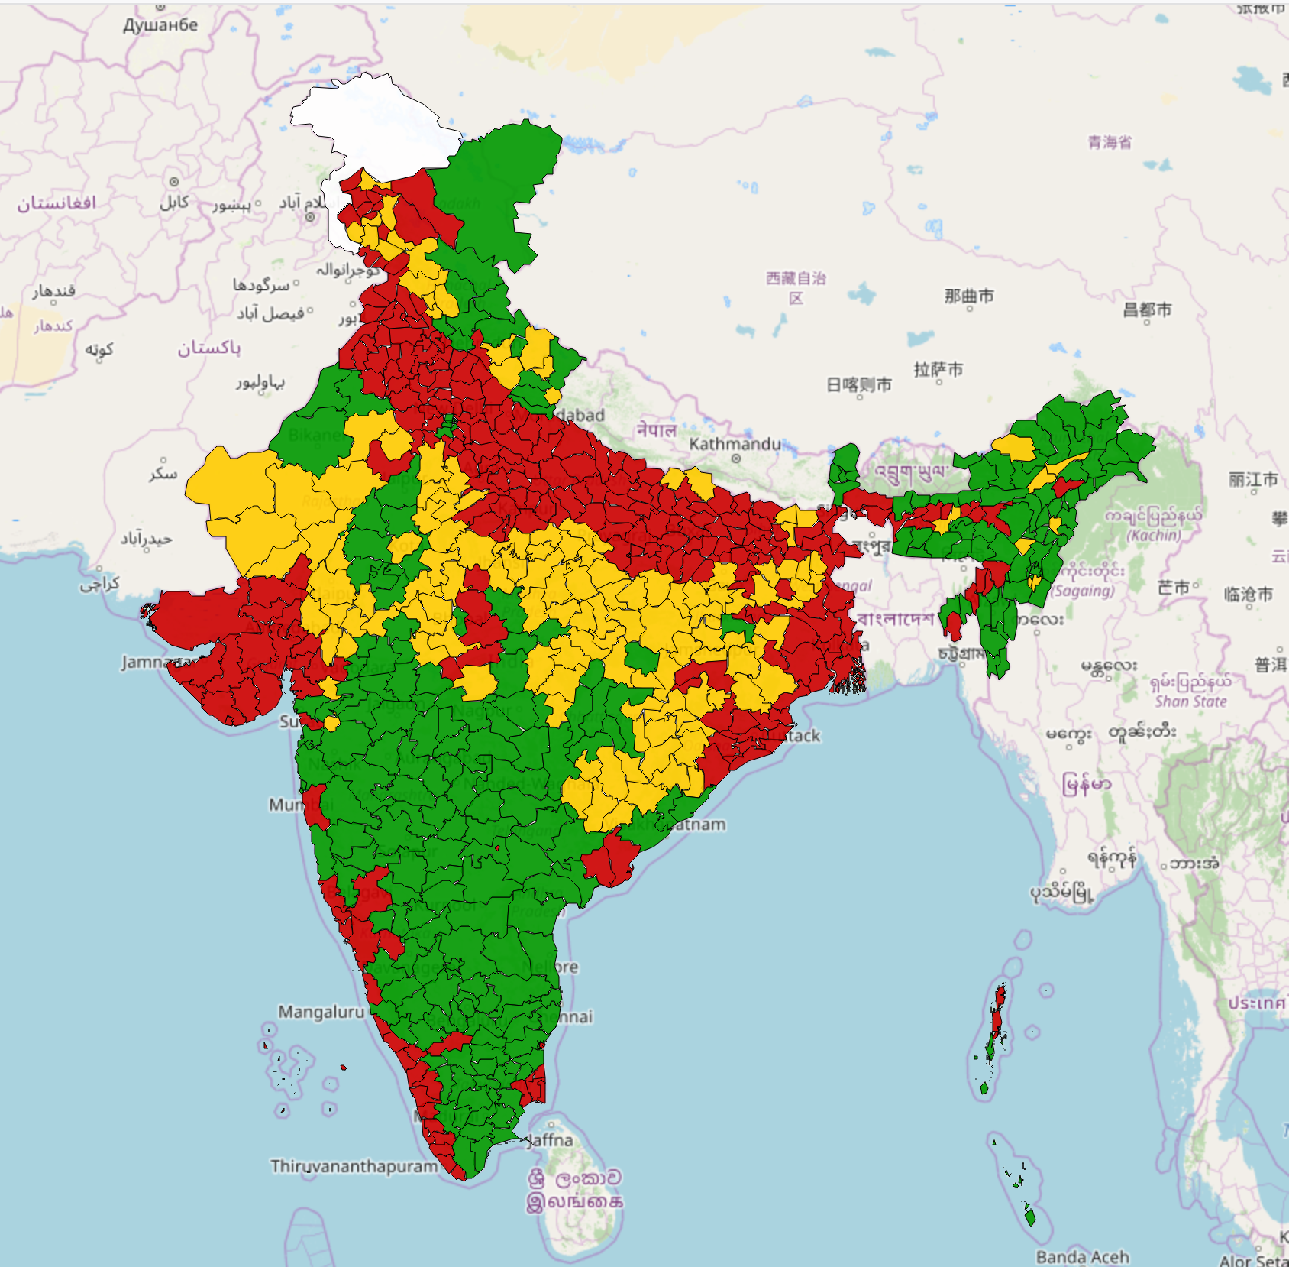
TYPE OF WORKERS
 | Non Workers
 | Marginal Workers
 | Main Workers
 | No Data
Migrants in North India have a higher incidence of non-workers
Migrants in Central India have a higher incidence of Marginal-workers
Migrants in Southern Peninsula and the North-eastern India have a higher incidence of main workers

Slide 19
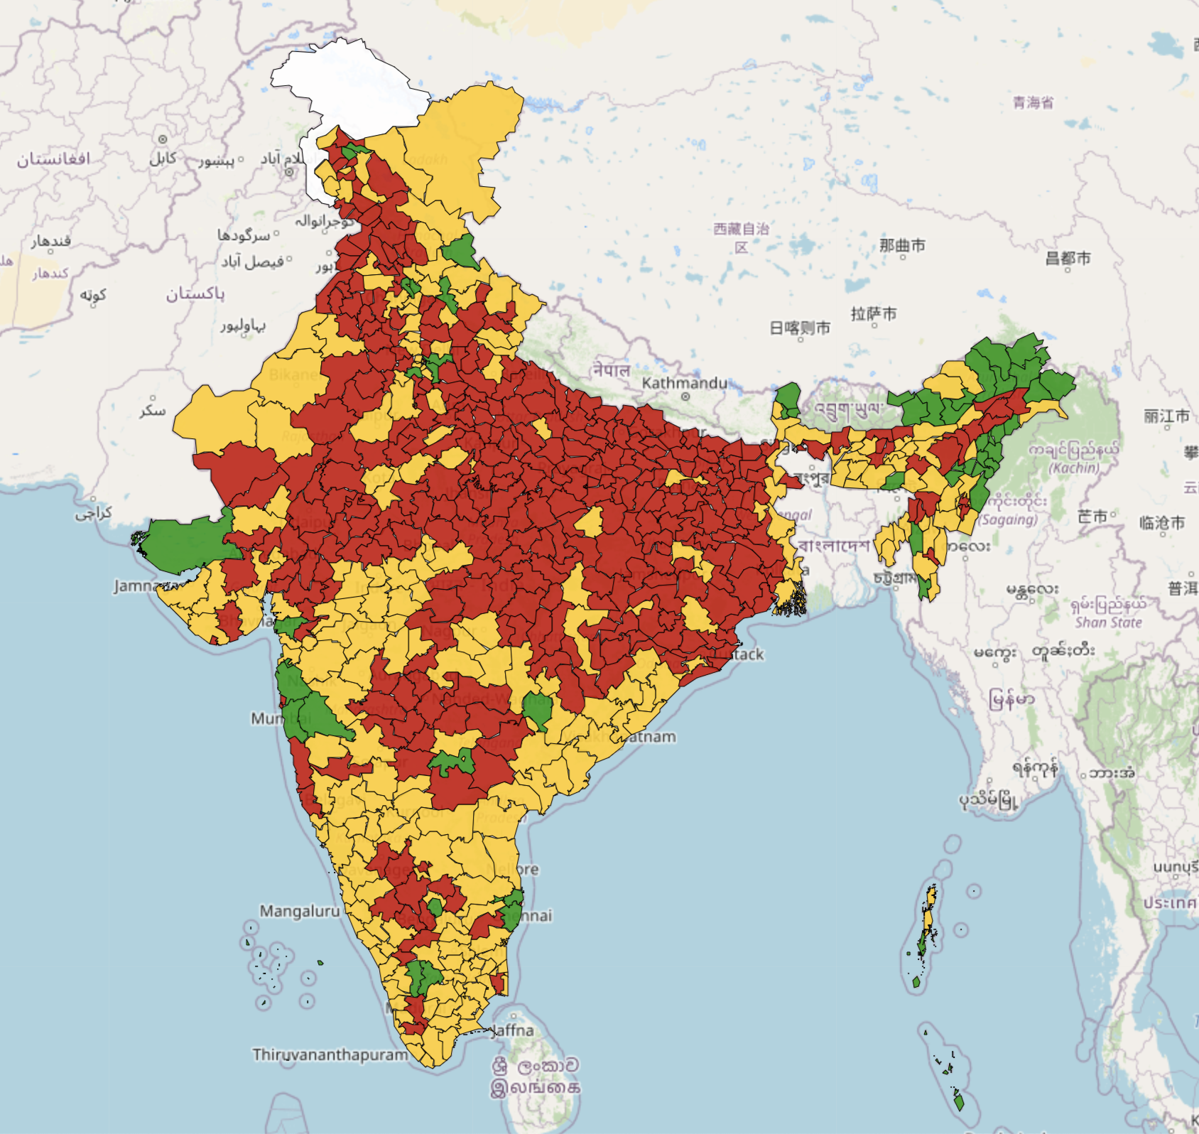
DURATION
 | Long Duration (20+ years)
 | Medium Duration (5-20 years)
 | Short Duration (1-5 years)
 | No Data
In districts like Delhi NCR, Surat, Kachchh, Arunachal Pradesh, Pune, Thane, Bangalore, Kancheepuram, Coimbatore, and Tiruppur have higher incidence of short-term migrants.
Migrants in North India have stayed there for longer durations.
Migrants in South India have stayed there for 5-20 years.

Slide 20
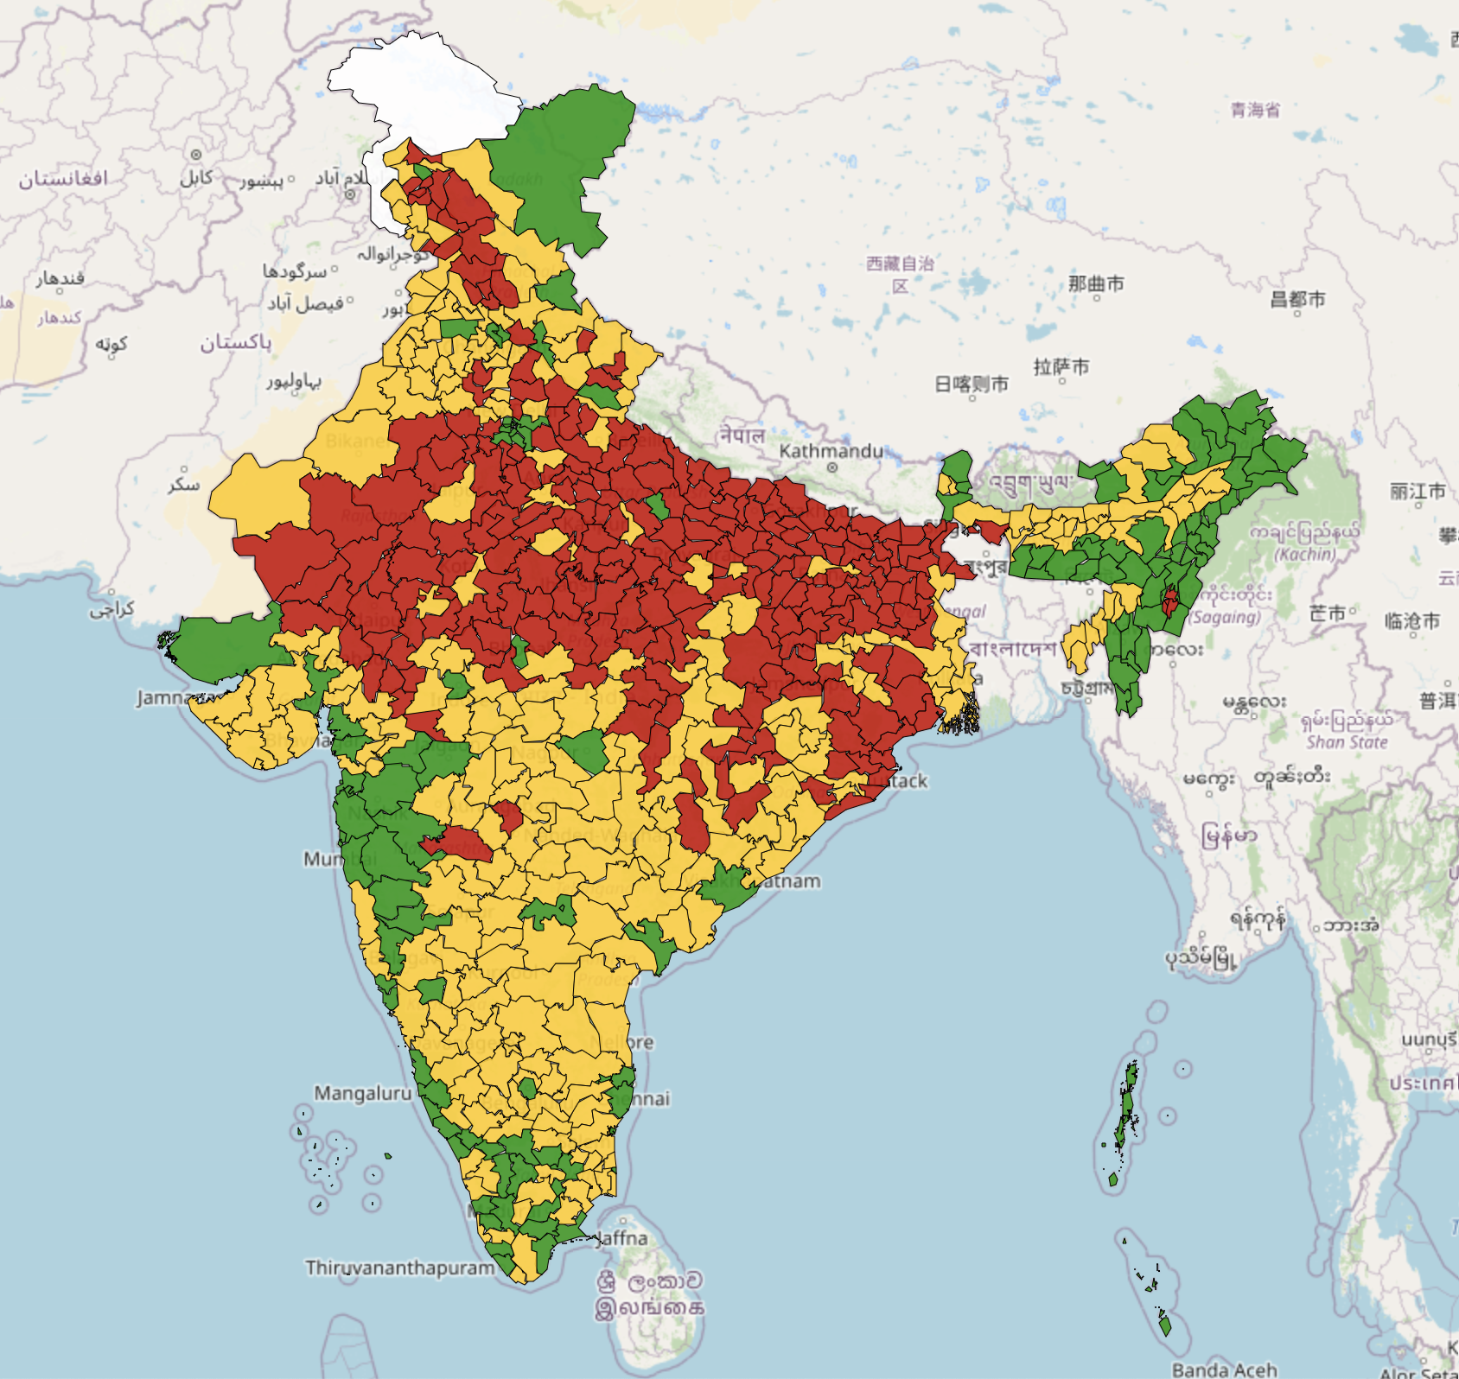
GENDER
 | High Gender Gap
 | Moderate Gender Gap
 | Low Gender Gap
 | No Data
Parts of northern India have higher incidence of female migrants.
The southern-west and north-eastern parts of India are more gender-neutral in terms of migrants.

Slide 21
LITERACY GAP
 | Illiterate dominant
 | Balanced Literates and Illiterates
 | Literate dominant
 | No Data
The megacities of India attract more literate migrants.
The Northern parts of India have higher incidence of Illiterate migrants

Slide 22
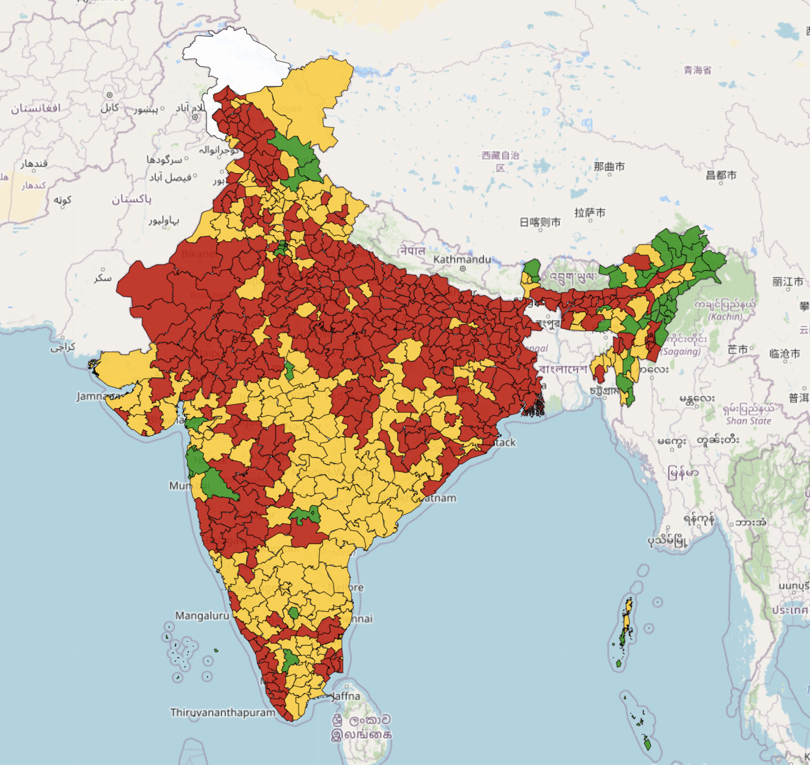
REASON GAP
 | Very High personal-professional gap
 | High personal-professional gap
 | Low personal-professional gap
 | No Data
Migrants living in districts like Bangalore, Thane, Tiruppur, Mumbai, Chennai, Surat, Delhi NCR, Hyderabad, Arunachal Pradesh have Low Personal-Professional Gap

Slide 23
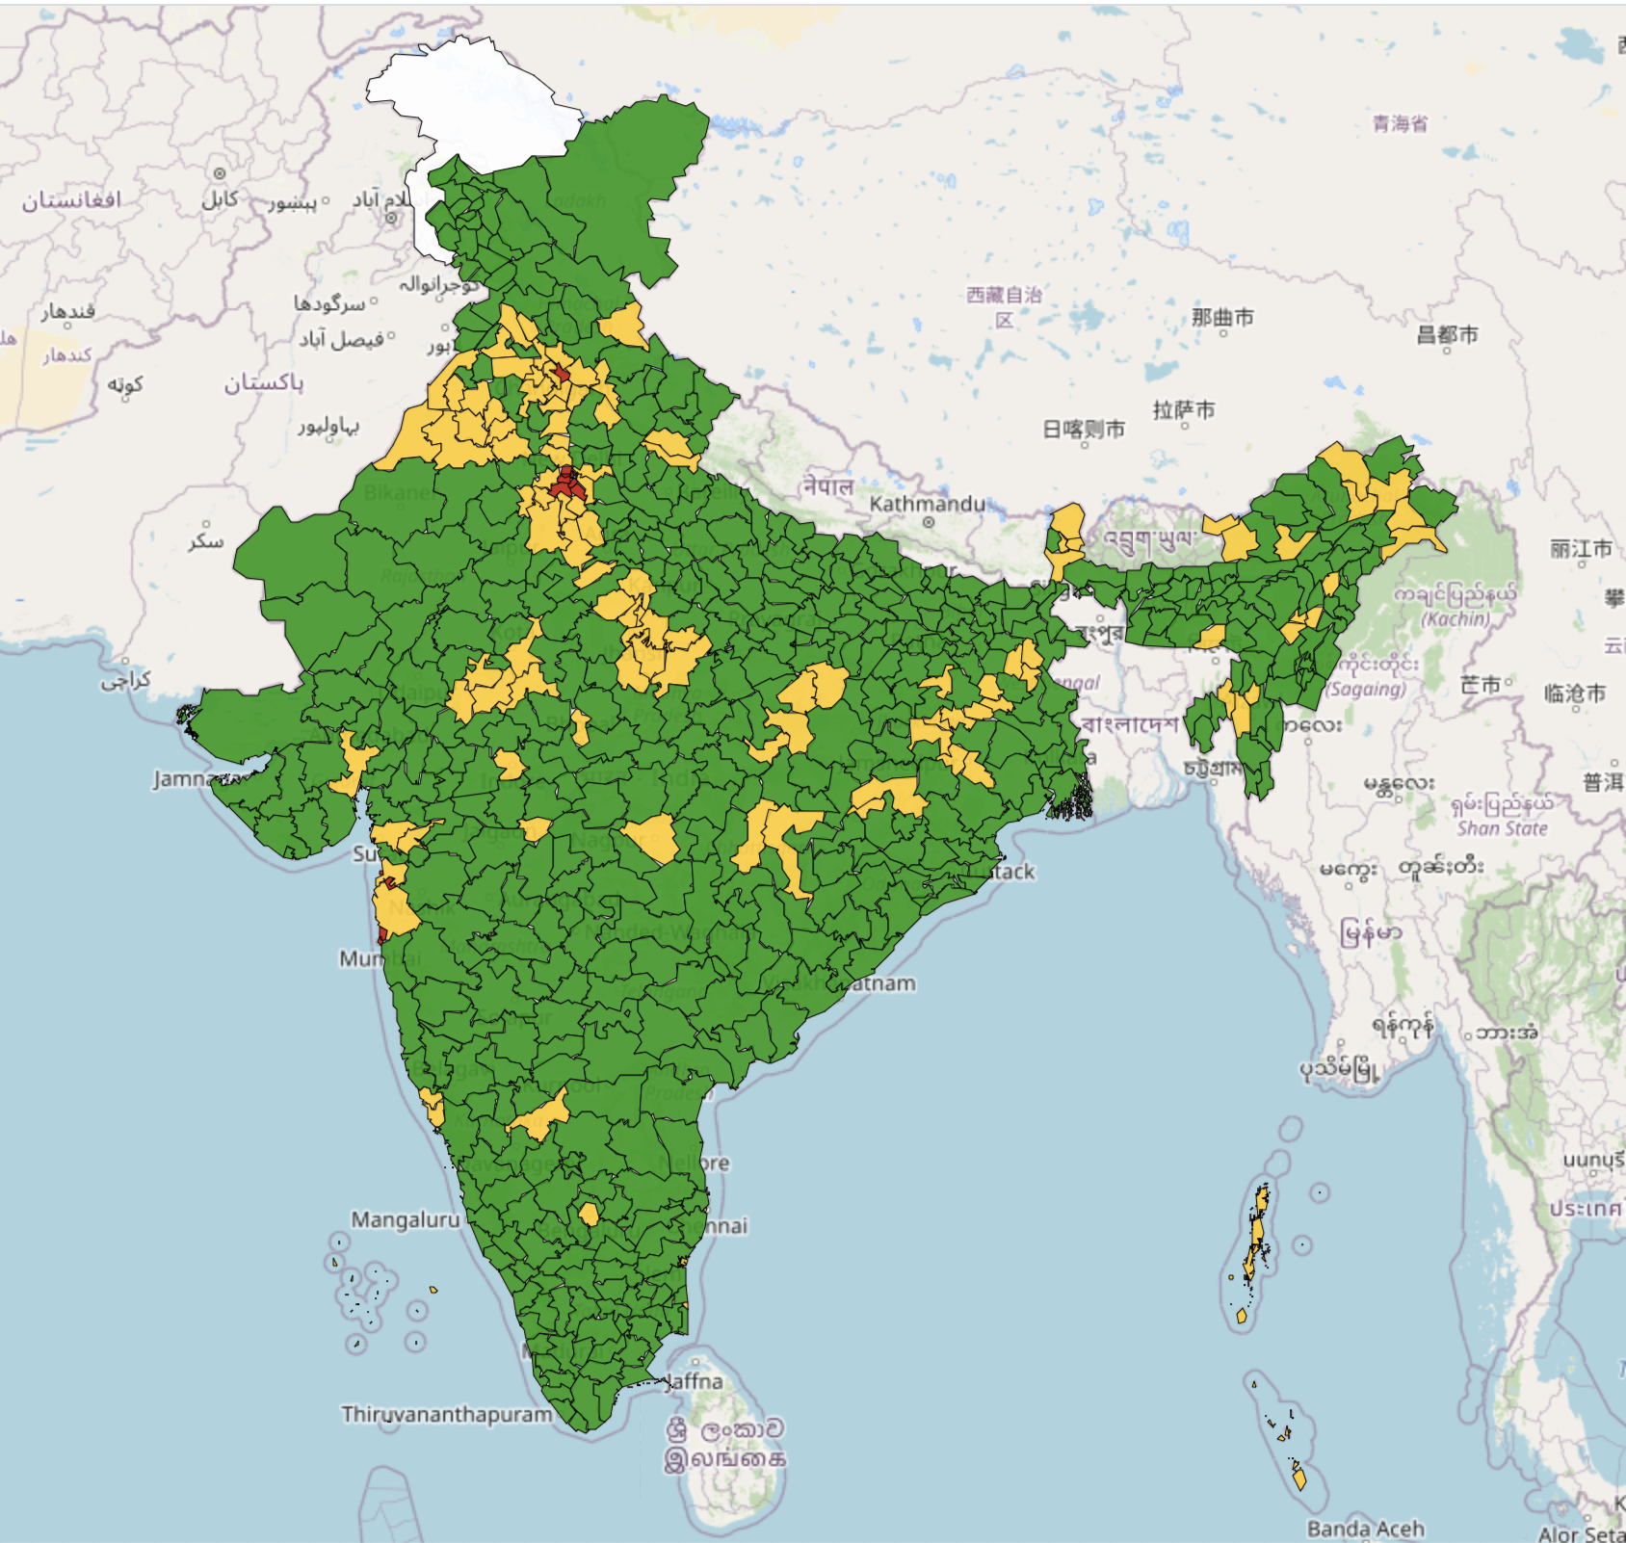
INTER & INTRA STATE MIGRATION
 | Inter-State dominant
 | Both Intra & Inter State
 | Intra-State dominant
 | No Data
Districts like Delhi, Chandigarh, Panchkula, Gurgaon, Faridabad, Diu, Daman, Dadra & Nagar Haveli, Mumbai Suburban, Mumbai, Puducherry have higher incidence of migrants migrating from other states

Slide 24
Tables of 2 factor analysis between Type of district (agri, non-agri, and unemployed) and different Migration Indicators

Slide 25
Shown is the percentage of districts at levels (as of 2011) for the three types of districts
Variable | Label | Unemployment(1) | Agricultural(2) | Non-agricultural(3)
Duration | Label 1: Long Term Migration | 47.96 | 25.87 | 26.16
 | Label 2: Medium Term Migration | 31.79 | 40.58 | 27.61
 | Label 3: Short Term Migration | 8.77 | 56.14 | 35.08
Type of Workers | Label 1: More Non Workers | 66.28 | 4.16 | 29.54
 | Label 2: All type of Workers | 35 | 60 | 5
 | Label 3: More Main Workers | 9.32 | 52.11 | 38.55
Inbound Migration | Label 1 (Low Inbound) | 59.92 | 26.45 | 13.61
 | Label 2 (Medium Inbound) | 27.61 | 47.01 | 25.37
 | Label 3 (High Inbound) | 15.65 | 20.86 | 63.47

Slide 26
Shown is the percentage of districts at levels (as of 2011) for the three types of districts
Variable | Label | Unemployment(1) | Agricultural(2) | Non-agricultural(3)
Reason Gap | Label 1: Very High personal professional gap | 48.89 | 25.96 | 25.13
 | Label 2: High personal professional gap | 29.43 | 40.18 | 30.37
 | Label 3: Low personal professional gap | 9.37 | 59.37 | 31.25
Gender of migrants | Label 1: Female Dominant | 57.28 | 38.19 | 45.31
 | Label 2: Gender Neutral | 17.96 | 39.08 | 42.96
Literacy Gap | Label 1: Illiterate dominant | 63.44 | 33.33 | 3.22
 | Label 2: Balanced Literates and Illiterates | 37.65 | 44.35 | 17.77
 | Label 3: Literate dominant | 17.67 | 23.25 | 59.06
Intra/Inter State Migration Gap | Label 1: Intra State dominant | 42.85 | 38.69 | 18.45
 | Label 2: Moderate Intra Inter state gap | 25.86 | 19.82 | 54.31
 | Label 3: Inter State dominant | 0 | 0 | 100

Slide 27
Non-agricultural districts see the highest inbound migration
Migrants in unemployment districts are mostly non-workers
Migrants in Unemployment districts stay there for longer duration (>20 years)
Migrants in Unemployment districts are mostly illiterate
Migrants travel for personal reasons to unemployment type districts
Unemployment districts have higher incidence of female migration
Non agricultural districts are found to have highly literate migrants
Key-Takeaways from Type of district to Migration indicator analysis

Slide 28
Two Factor Analysis
(on 2011 District wise data)

Slide 29
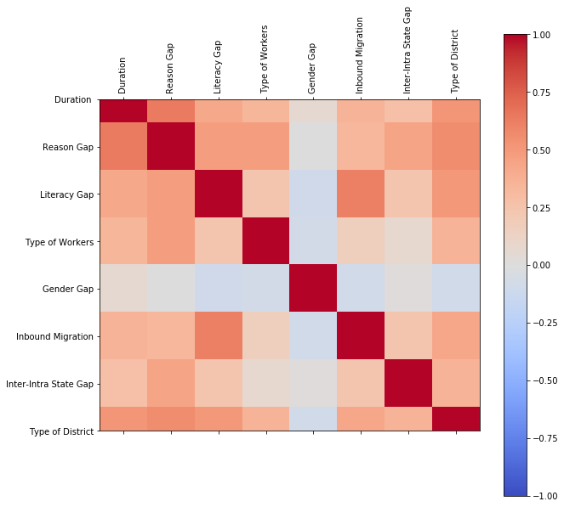
Moderate correlation (0.5-0.7) is observed between-
Duration & Reason Gap
Duration & Type of District
Reason & Type of District
Literacy Gap & Inbound Migration
Literacy Gap & Type of District
Metric used here is Pearson Correlation

Slide 30
Correlation Analysis between different variables of migration: Pearson’s coefficient
 | Duration | Reason Gap | Literacy Gap | Type of Workers | Gender Gap | Inbound Migration | Inter-Intra State Gap | Type of District
Duration | 1.000000 | 0.637769 | 0.415292 | 0.340388 | 0.067760 | 0.352461 | 0.274615 | 0.513880
Reason Gap |  | 1.000000 | 0.470744 | 0.470166 | -0.000394 | 0.332168 | 0.439572 | 0.560615
Literacy Gap |  |  | 1.000000 | 0.235770 | -0.096110 | 0.616513 | 0.234527 | 0.501714
Type of Workers |  |  |  | 1.000000 | -0.071806 | 0.157211 | 0.074189 | 0.358417
Gender Gap |  |  |  |  | 1.000000 | -0.086787 | 0.011692 | -0.090001
Inbound Migration |  |  |  |  |  | 1.000000 | 0.235474 | 0.421899
Inter-Intra State Gap |  |  |  |  |  |  | 1.000000 | 0.352022
Type of District |  |  |  |  |  |  |  | 1.000000

Slide 31
Creation of Hypotheses based on 2-factor analysis between migration variables

Slide 32
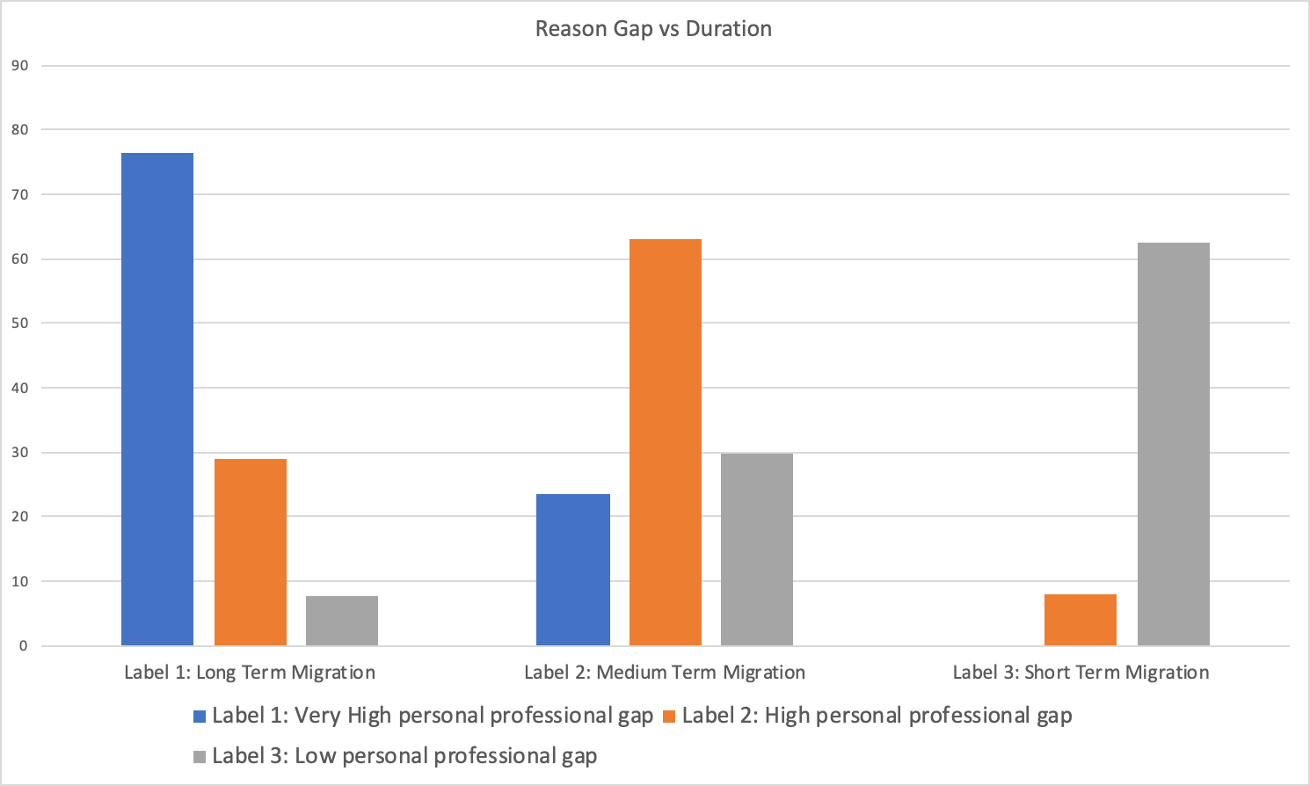
Hypothesis 1: People migrate for shorter durations for both personal and professional reasons equally. However, personal reasons for migration (like marriage.. etc.) drive migration for longer-terms.
The Pearson’s coefficient of correlation between the variables Duration of migration and Reason for migration gap = 0.637769
This can be considered as a Moderate correlation

Slide 33
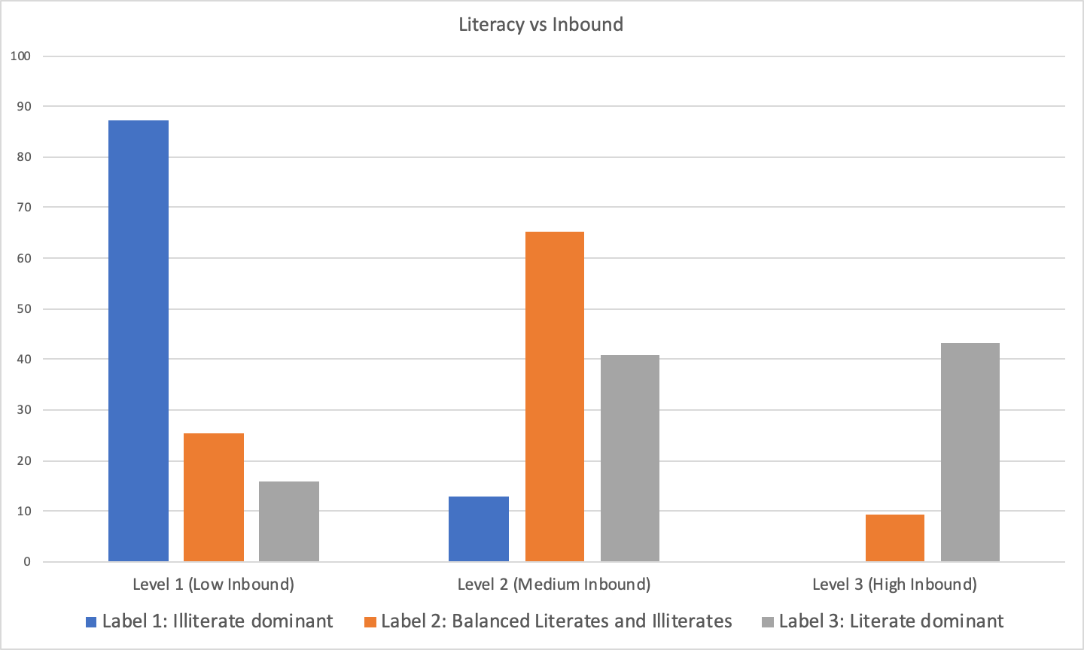
Hypothesis 2: Districts with higher inbound migration have higher incidence of Literate migrants
The Pearson’s coefficient of correlation between the variables %Inbound migrants and Literacy = 0.616513
This can be considered as a Moderate correlation

Slide 34
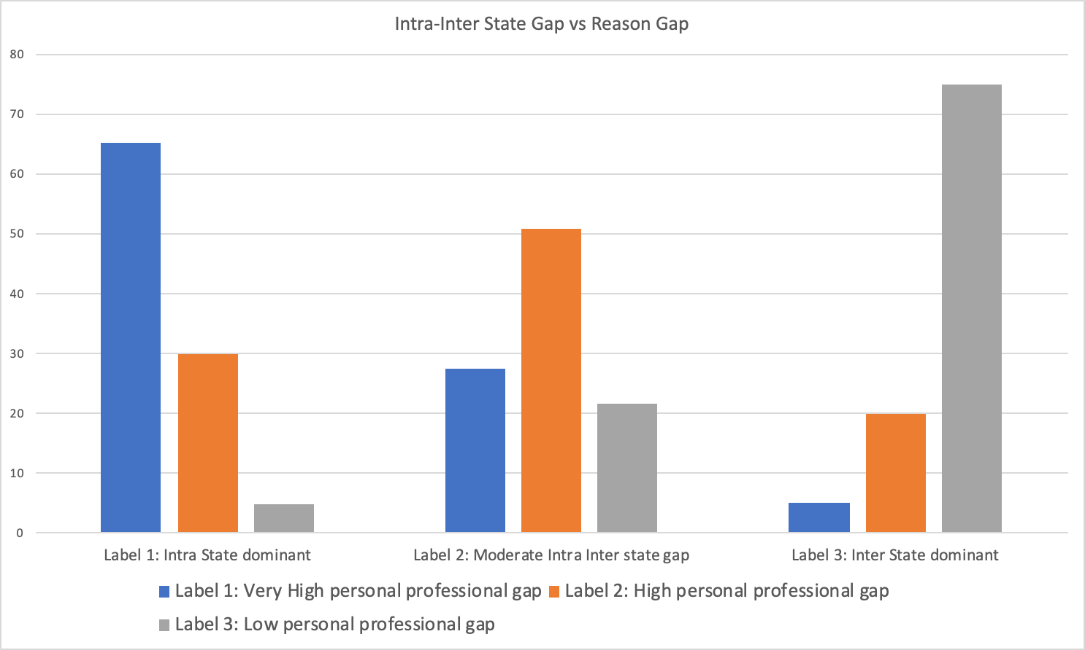
Hypothesis 3: Intra-state migration is mostly driven by personal reasons, while Inter-state migration is driven by both personal and professional reasons.

Slide 35
Hypothesis 4: People migrate for shorter durations for professional reasons

Slide 36
Creation of Hypotheses based on 2-factor analysis between migration indicators and type of district (Agri, Non-agri, and Unemployed)

Slide 37
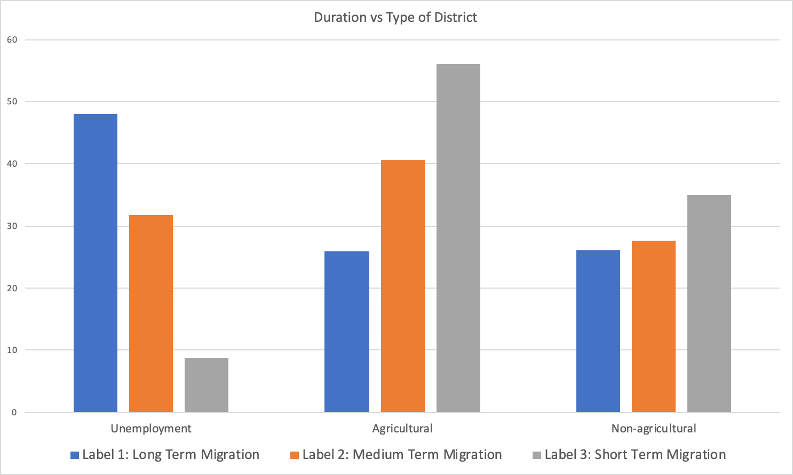
Hypothesis 5: Agricultural districts have higher incidence of short-term migrants, possibly due to the seasonal nature of the work.
The Pearson’s coefficient of correlation between the variables Type of district and %Inbound migrants = 0.513880
This can be considered as a Moderate correlation

Slide 38
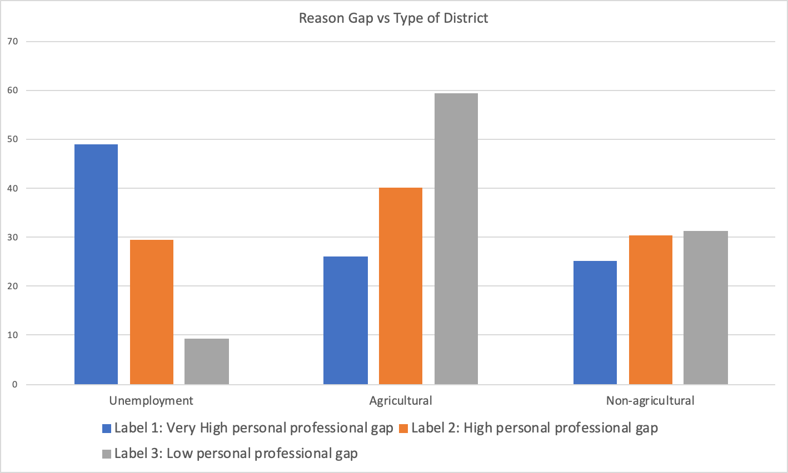
Hypothesis 6: Both Unemployed and Non-agricultural districts have higher incidence of migrants migrating for personal reasons. However, in Agricultural districts people migrate equally for both personal and professional reasons.
The Pearson’s coefficient of correlation between the variables Type of district and Reason for migration gap = 0.560615
This can be considered as a Moderate correlation

Slide 39
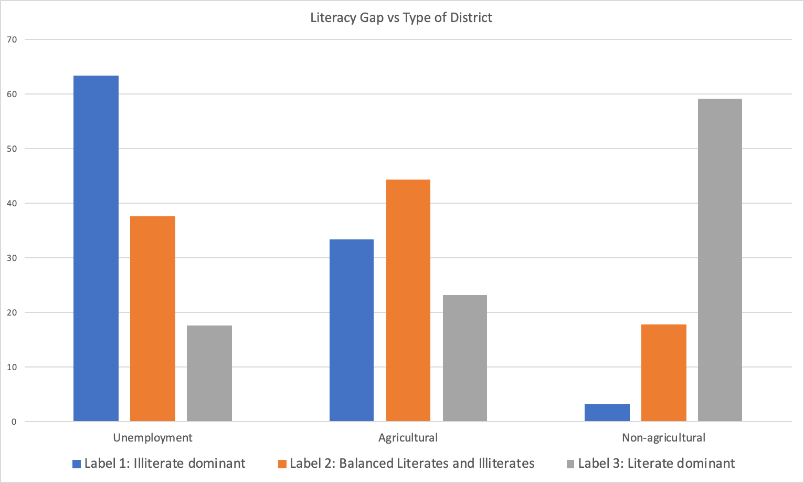
Hypothesis 7: Both Unemployed and agricultural districts have higher incidence of illiterate migrants. However, Non-agricultural districts have higher incidence of literate migrants.
The Pearson’s coefficient of correlation between the variables Type of district and Literacy gap = 0.501714
This can be considered as a Moderate correlation

Slide 40
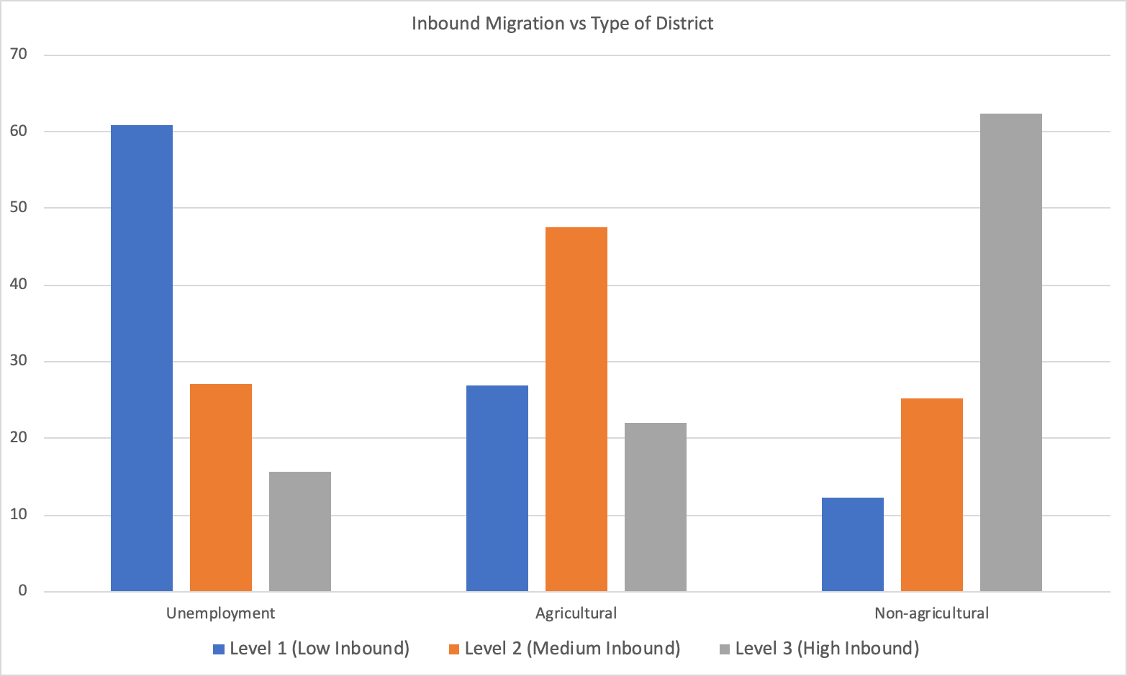
Hypothesis 8: Non-agricultural districts have the highest incidence of inbound migrants

Slide 41
Creation of Hypotheses based on 2-factor analysis between migration indicators and socio-economic indicators

Slide 42
Pearson’s correlation coefficient between migration indicators and socio-economic indicators
 | ASSET | BF | CHH | FC | LIT | MSW | MSL | FEMP(formal employment) | ADI | Female_Main(female main employment)
Duration | 0.277769 | 0.417422 | 0.348822 | 0.148411 | 0.238064 | 0.202294 | 0.384942 | 0.467072083 | 0.375925417 | 0.203121538
Reason Gap | 0.322522 | 0.458639 | 0.386198 | 0.239341 | 0.317153 | 0.335022 | 0.434954 | 0.467604022 | 0.470177966 | 0.198980509
Literacy Gap | 0.509091 | 0.556304 | 0.502432 | 0.262346 | 0.811983 | 0.20885 | 0.589568 | 0.656170965 | 0.761639823 | 0.104881948
Type of Workers | 0.0679 | 0.013252 | 0.299635 | -0.17542 | 0.076003 | 0.195877 | 0.355523 | 0.139235512 | 0.097193017 | 0.706834387
Gender Gap | -0.03426 | 0.033137 | -0.13739 | 0.081032 | -0.0777 | -0.01621 | -0.15961 | -0.027566737 | -0.046951276 | -0.123207143
Inbound Migration | 0.543312 | 0.466091 | 0.51604 | 0.274855 | 0.508789 | 0.299869 | 0.598015 | 0.590024384 | 0.620215636 | 0.084471571
Intra- Inter State Migration | 0.358989 | 0.407241 | 0.248736 | 0.410786 | 0.252616 | 0.202972 | 0.271578 | 0.364329725 | 0.4250359 | -0.210843164
Type Of Districts | 0.444461 | 0.501159 | 0.468407 | 0.244593 | 0.430312 | 0.177171 | 0.519584 | 0.579313167 | 0.549508807 | 0.252966323

Slide 43
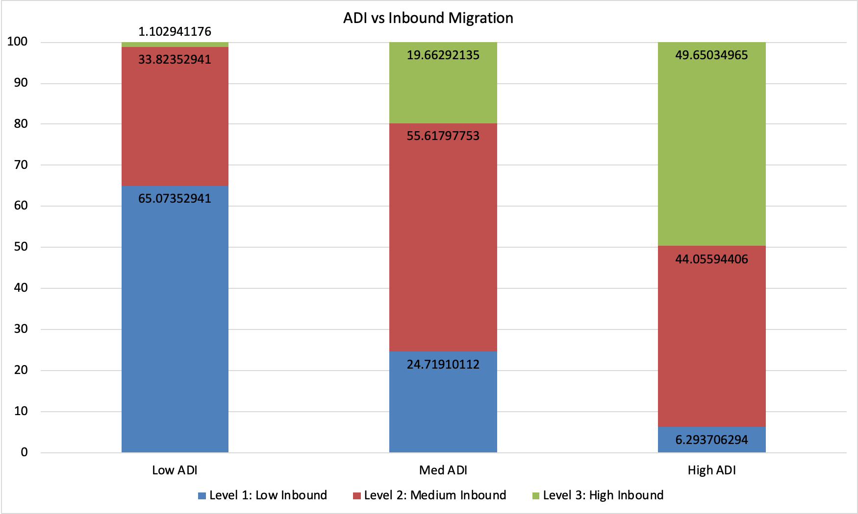
Hypothesis 9: Districts with better socio-economic indicators (like Assets, MSL, CHH, LIT) have higher incidence of inbound migrants. Equivalently, districts with higher ADI values have incidence of inbound migrants
The Pearson’s coefficient of correlation between the ADI value and %inbound migrants = 0.620215636
This can be considered as a moderate correlation
The bar graphs corresponding to each of these socio-economic indicators with %inbound migrants in shown in the next slides as proof

Slide 44
High Inbound vs Medium Inbound
Indicator | t-statistic | p-value
ADI | 9.04607597 | 9.30E-18
High Inbound vs Low Inbound
Indicator | t-statistic | p-value
ADI | 21.95080403 | 6.08E-67
Medium Inbound vs Low Inbound
Indicator | t-statistic | p-value
ADI | 10.1379879 | 5.05E-22

Slide 45
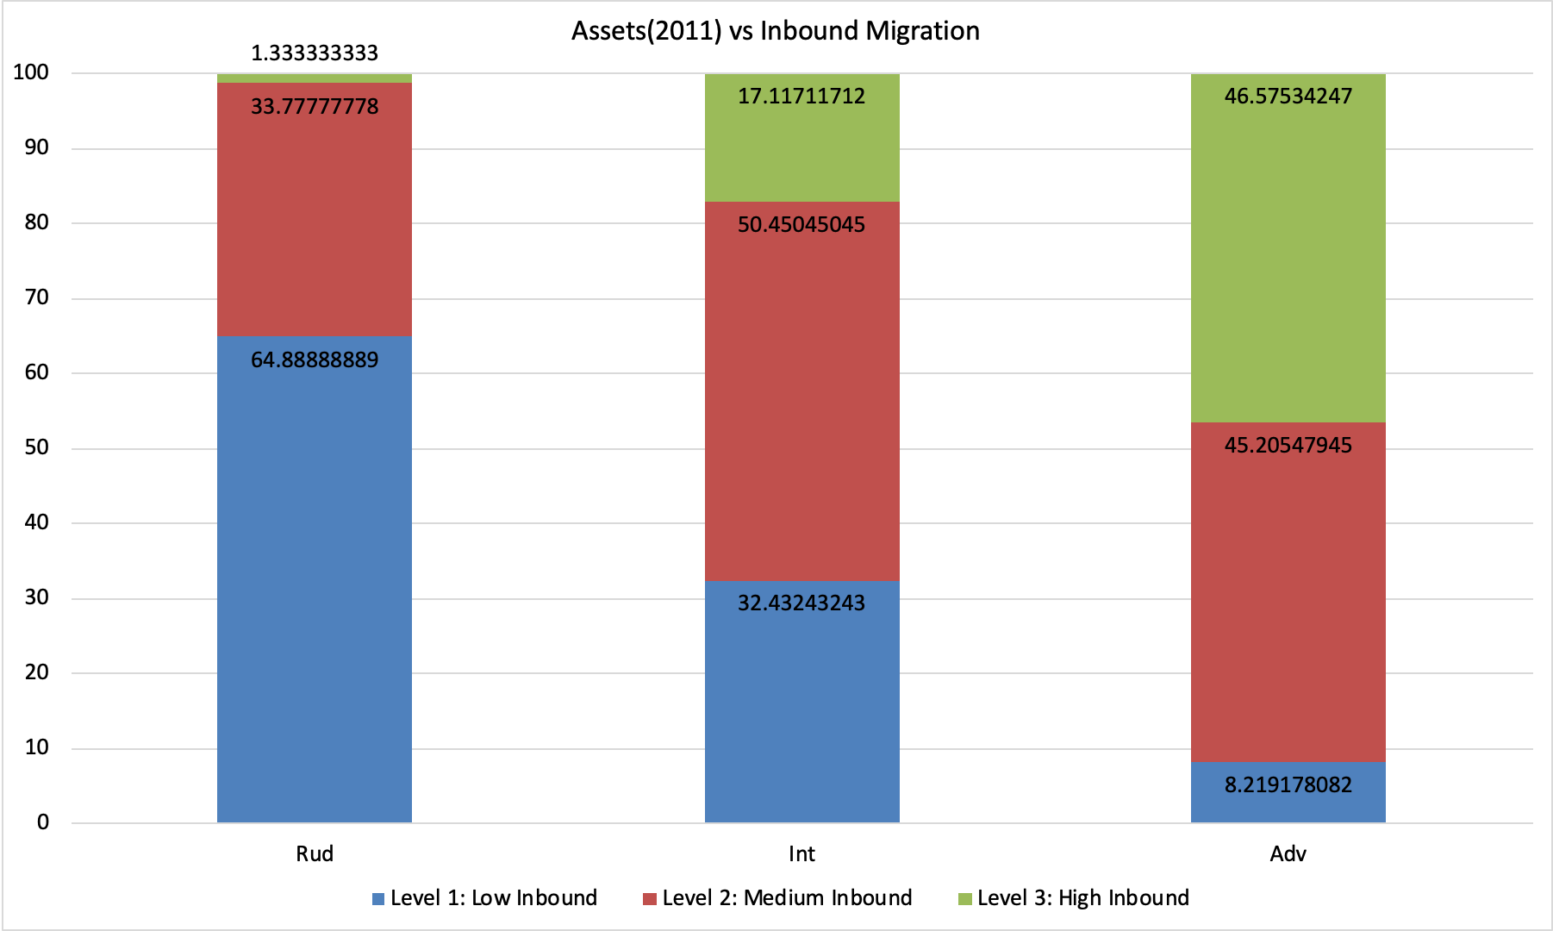
→ Districts with advance levels of ASSETS have higher incidence of inbound migrants
→ Districts with lower levels of ASSETS have lower incidence of inbound migrants

Slide 46
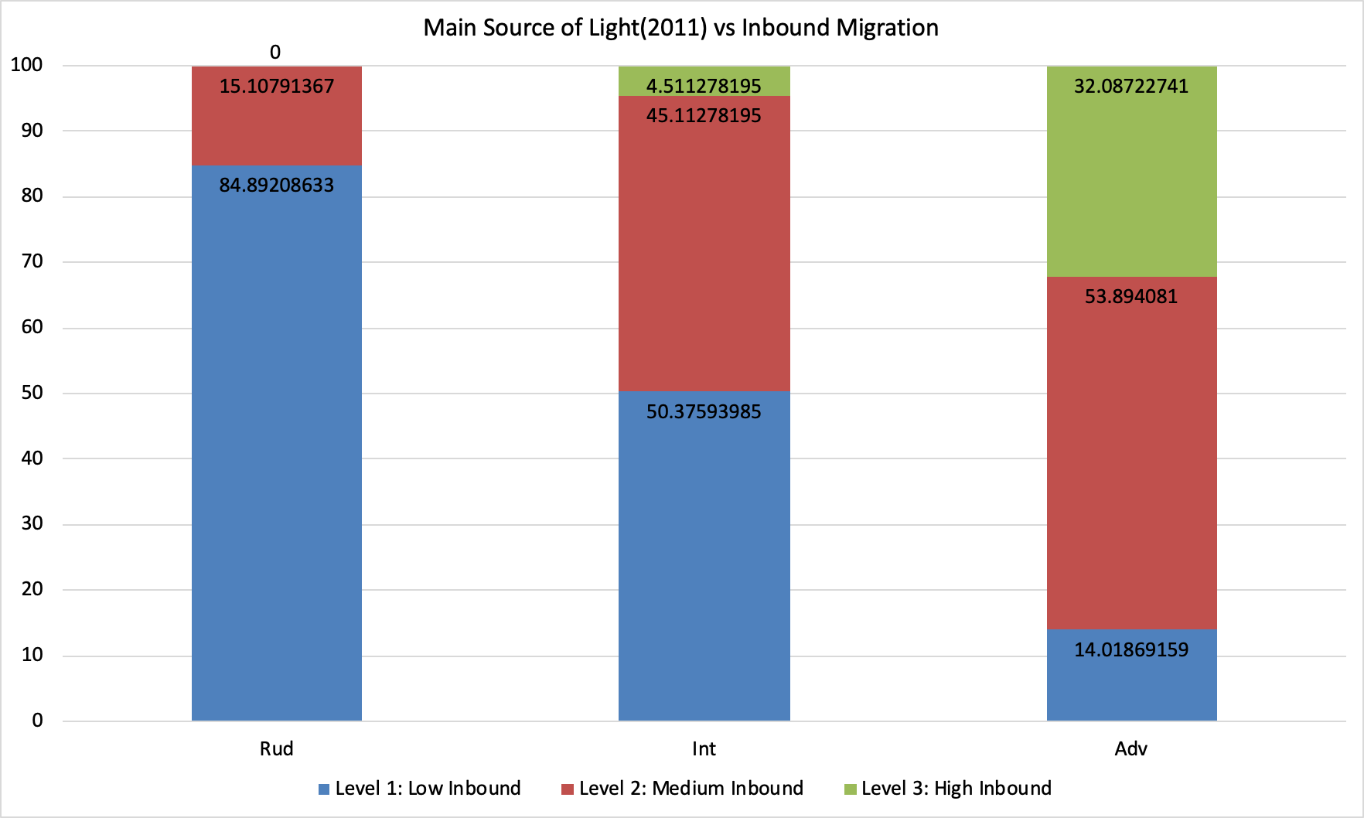
→ Districts with advance level of MSL have higher incidence of inbound migrants
→ Districts with lower level of MSL have lower incidence of inbound migrants

Slide 47
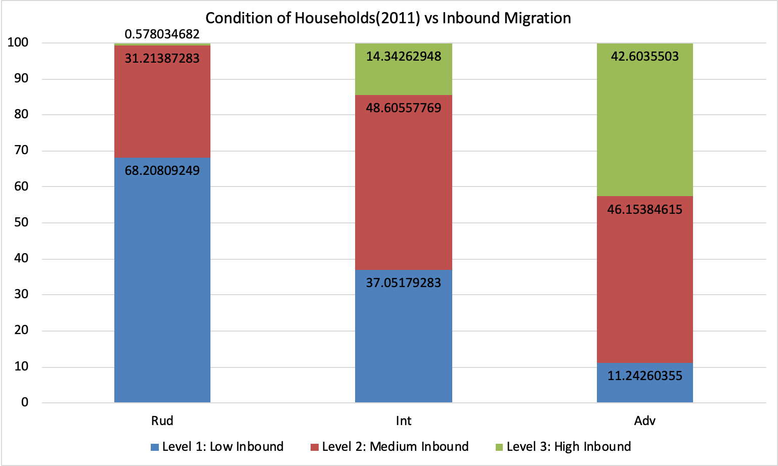
→ Districts with advance CHH have higher incidence of inbound migrants
→ Districts with lower CHH of literacy have lower incidence of inbound migrants

Slide 48
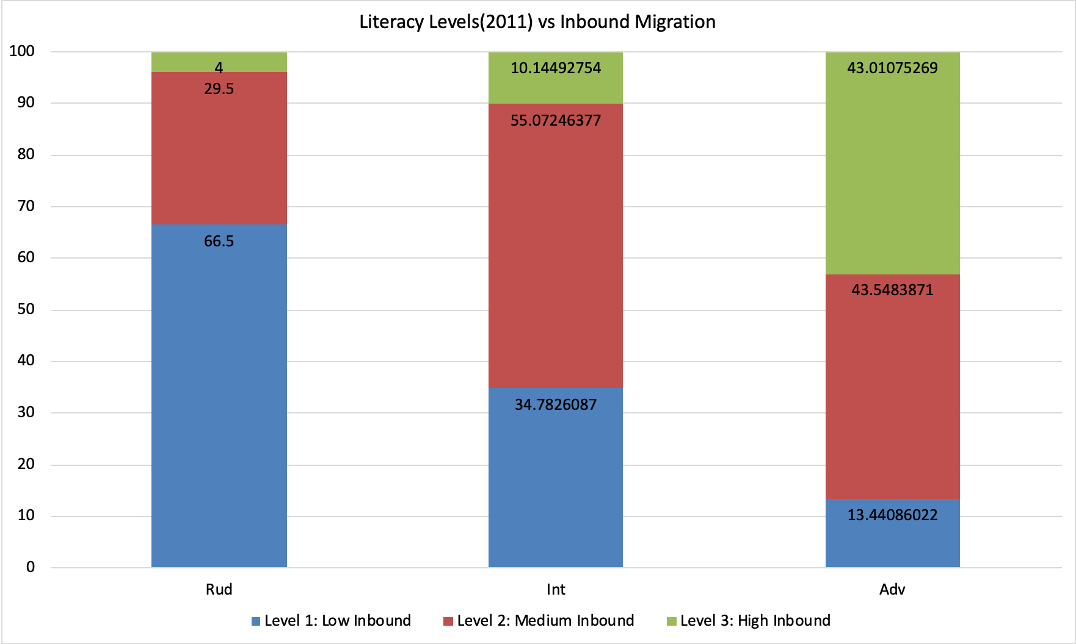
→ Districts with advance literacy have higher incidence of inbound migrants
→ Districts with lower levels of literacy have lower incidence of inbound migrants

Slide 49
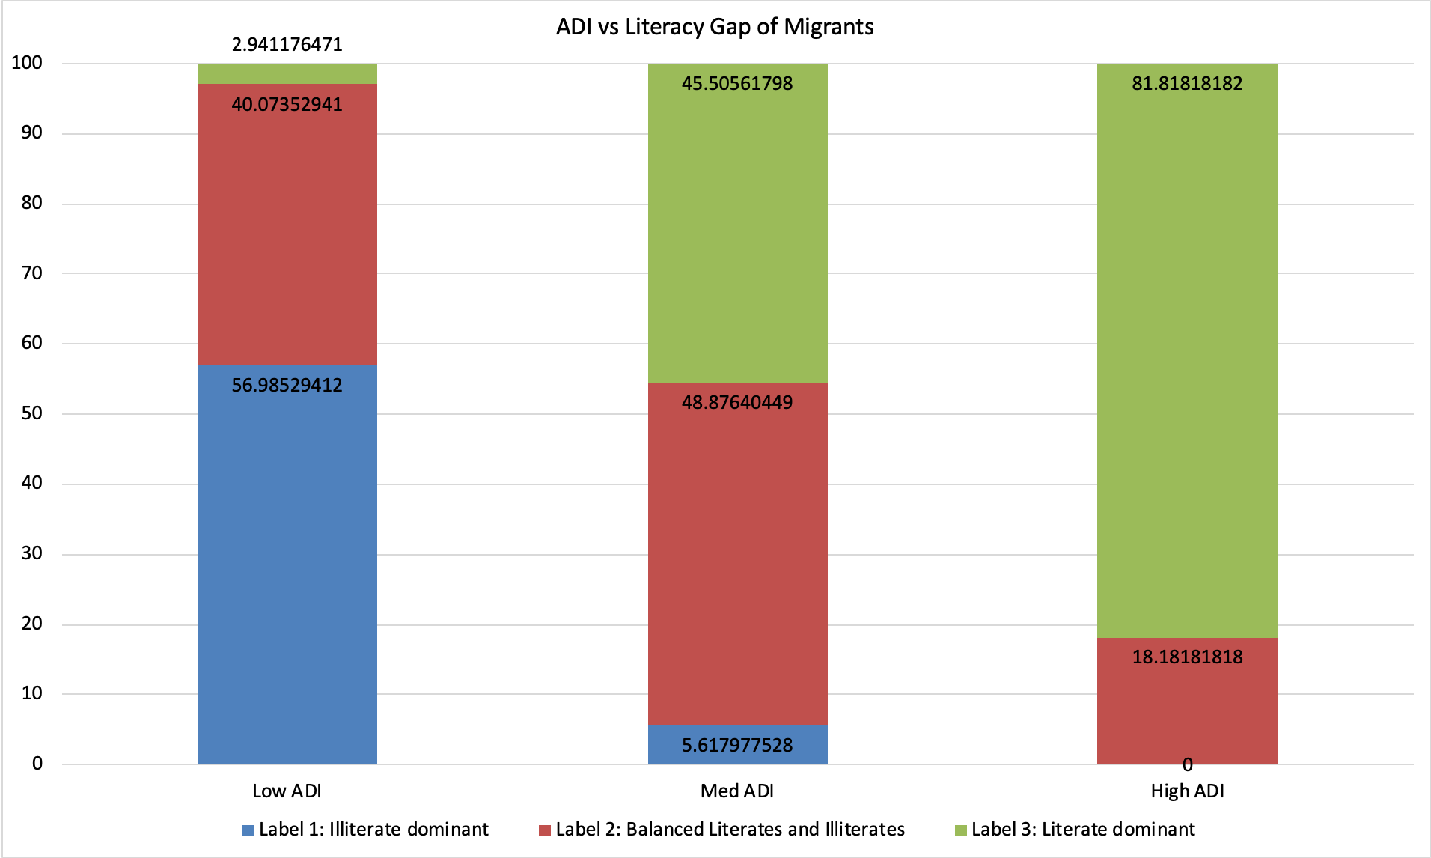
Hypothesis 10: Districts with better socio-economic indicators (like Assets, MSL, CHH, BF, FEMP) have higher incidence of literate migrants. Equivalently, districts with higher ADI values have incidence of literate migrants
The Pearson’s coefficient of correlation between the ADI value and %inbound migrants = 0.76163982
This can be considered as a High correlation
The bar graphs corresponding to each of these socio-economic indicators with literacy gap of migrants in shown in the next slides as proof

Slide 50
Literate Dominant vs Balanced Literates and Illiterates
Indicator | t-statistic | p-value
ADI | 14.72007746 | 6.06E-40
Literate Dominant vs Illiterate dominant
Indicator | t-statistic | p-value
ADI | 30.82689189 | 4.00E-104
Balanced Literates and Illiterates vs Illiterate dominant
Indicator | t-statistic | p-value
ADI | 10.1392733 | 1.43E-21

Slide 51
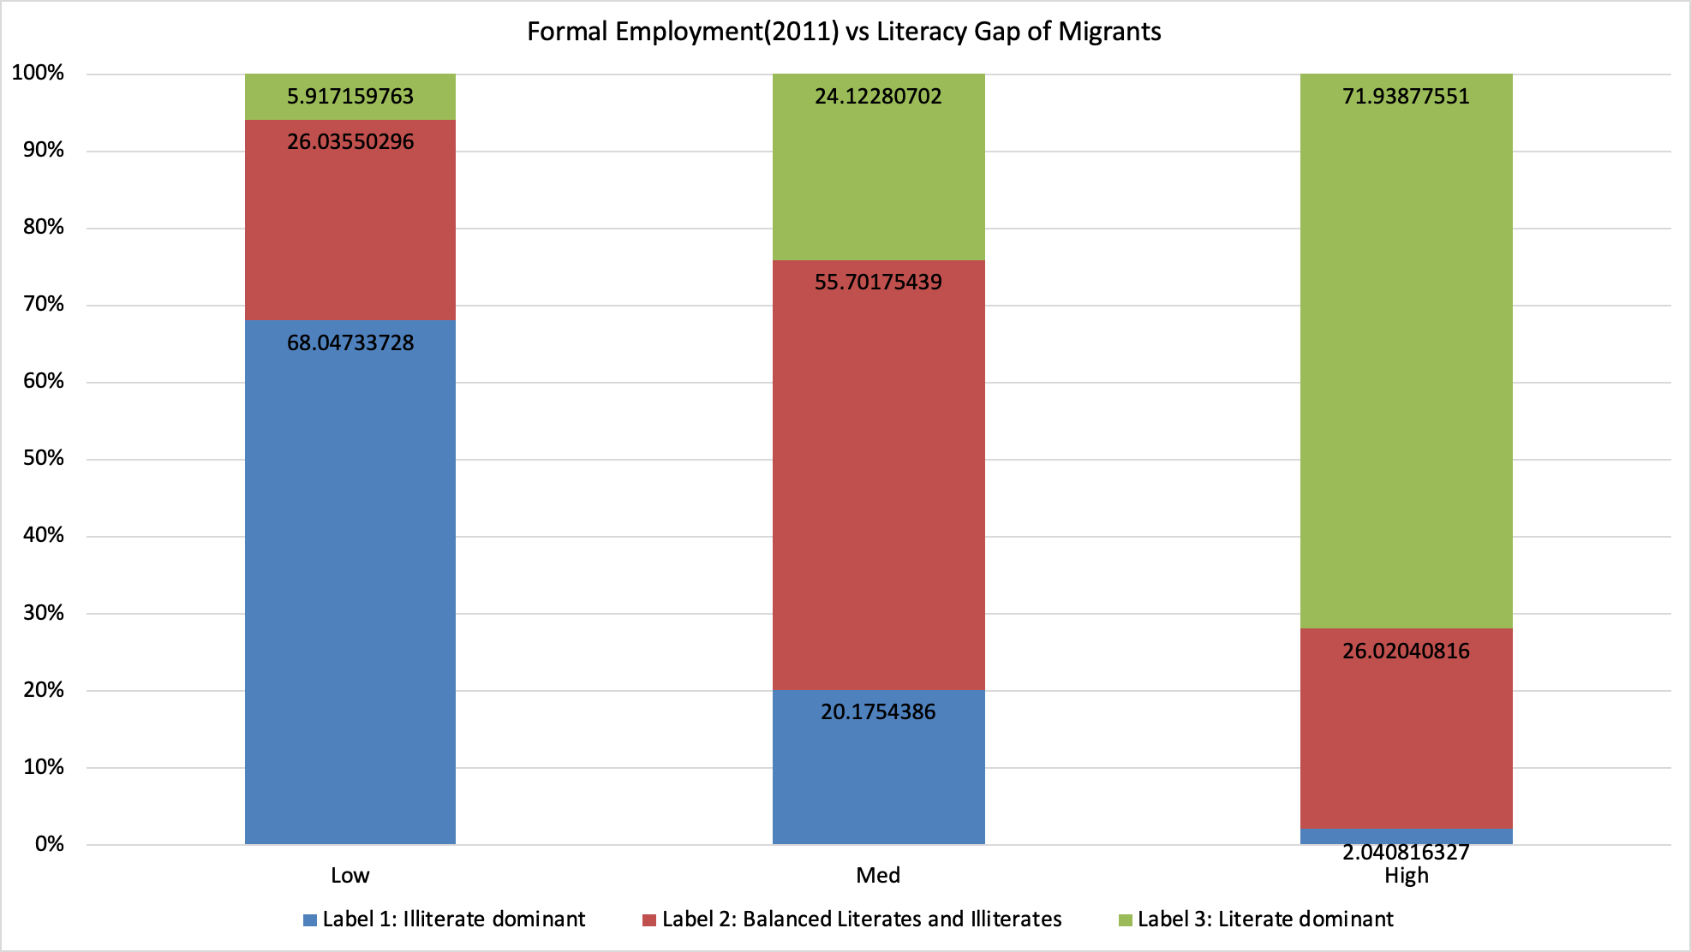
→ Districts with better levels of formal employment (FEMP) have higher incidence of literate migrants

Slide 52
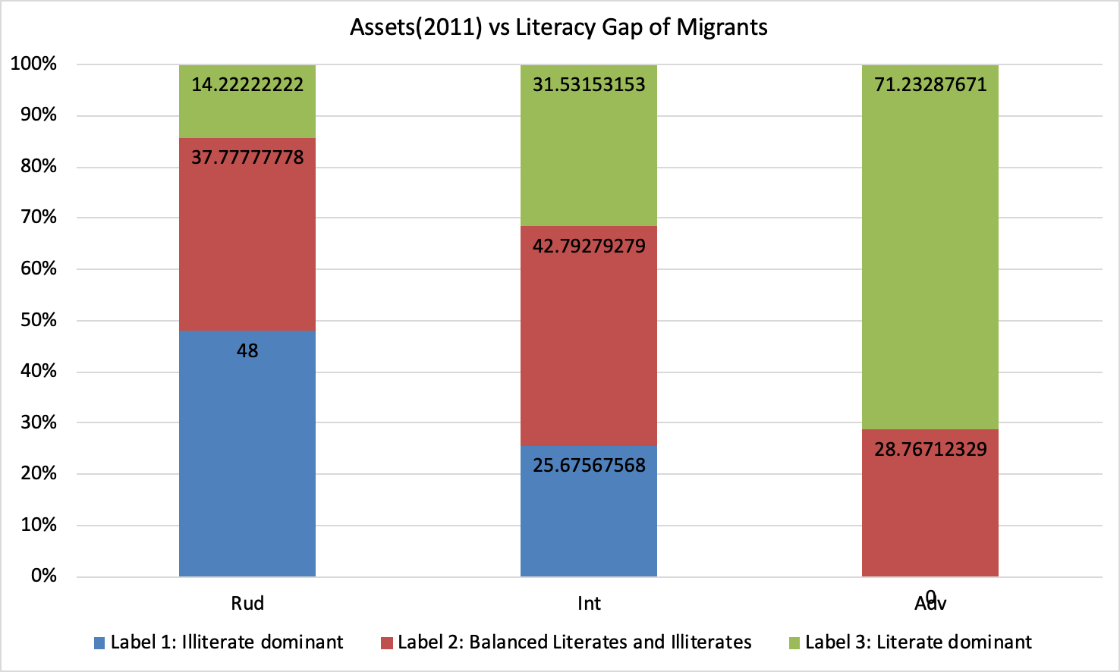
→ Districts with better levels of Assets have higher incidence of literate migrants

Slide 53
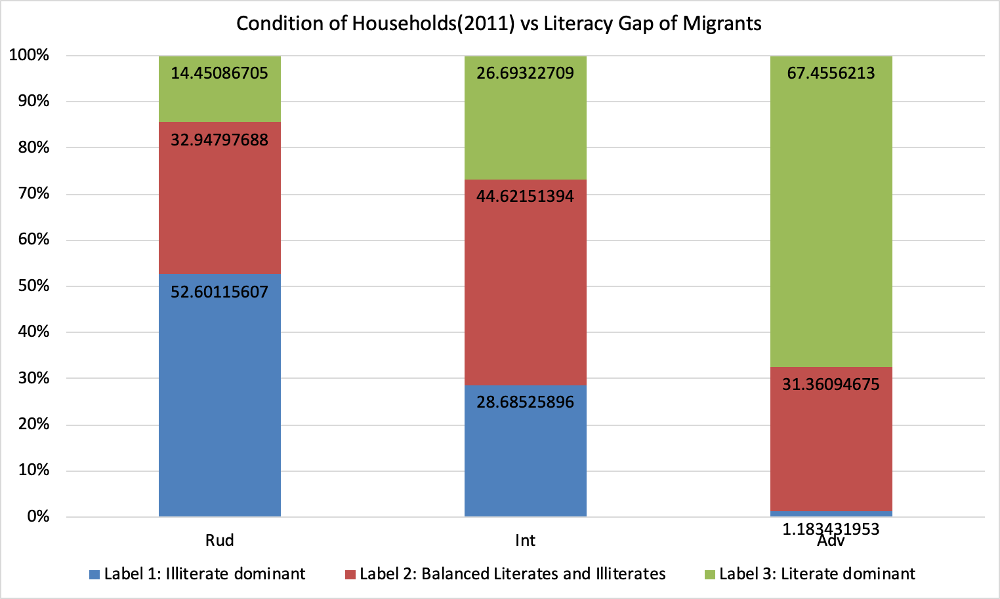
→ Districts with better Condition of Household (CHH) have higher incidence of literate migrants

Slide 54
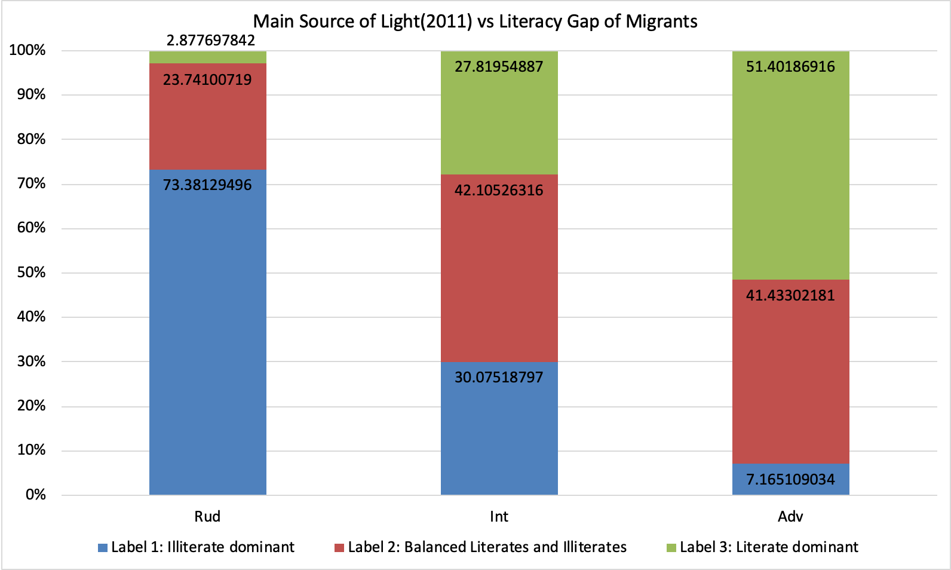
→ Districts with better levels of Main source of light (MSL) have higher incidence of literate migrants

Slide 55
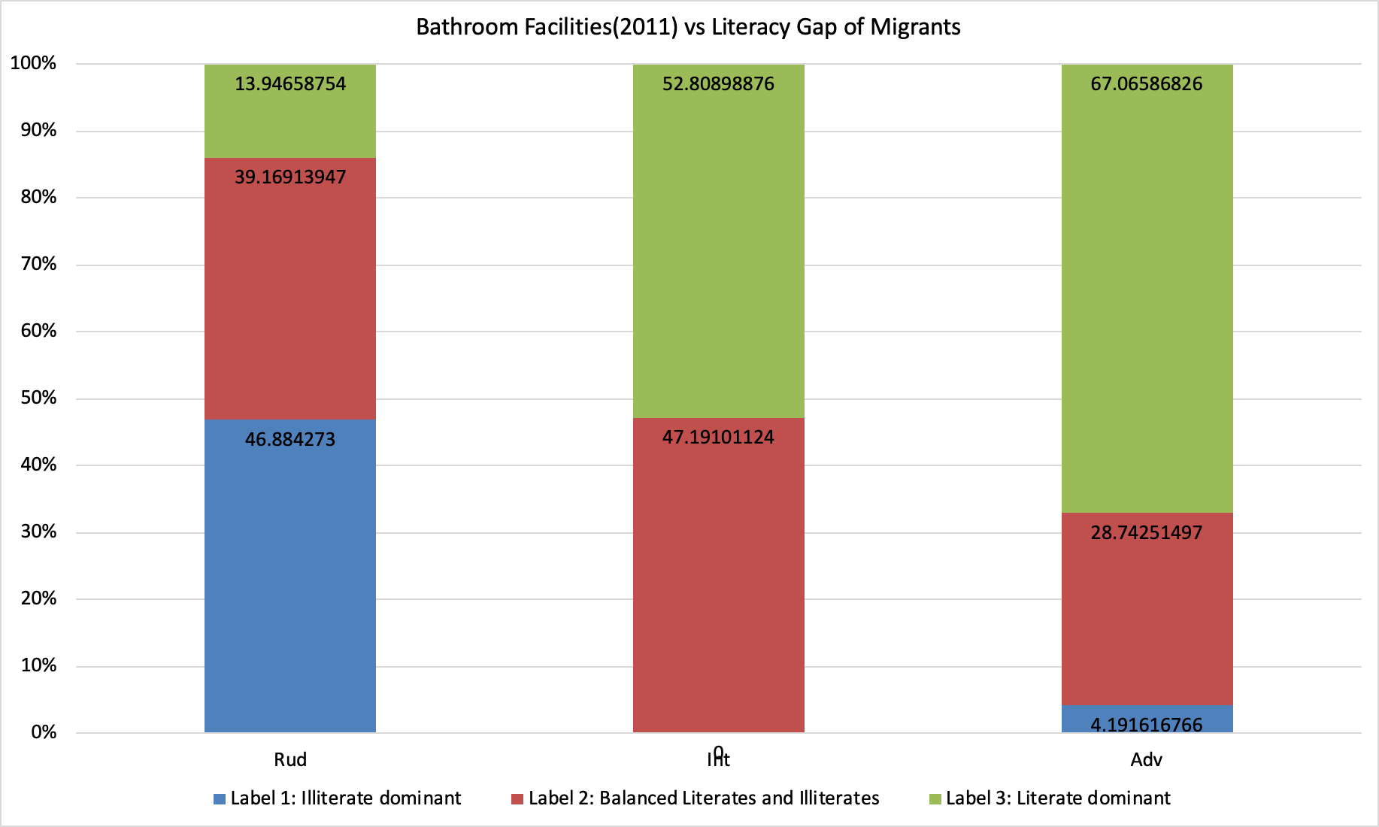
→ Districts with better levels of Bathroom facilities (BF) have higher incidence of literate migrants

Slide 56
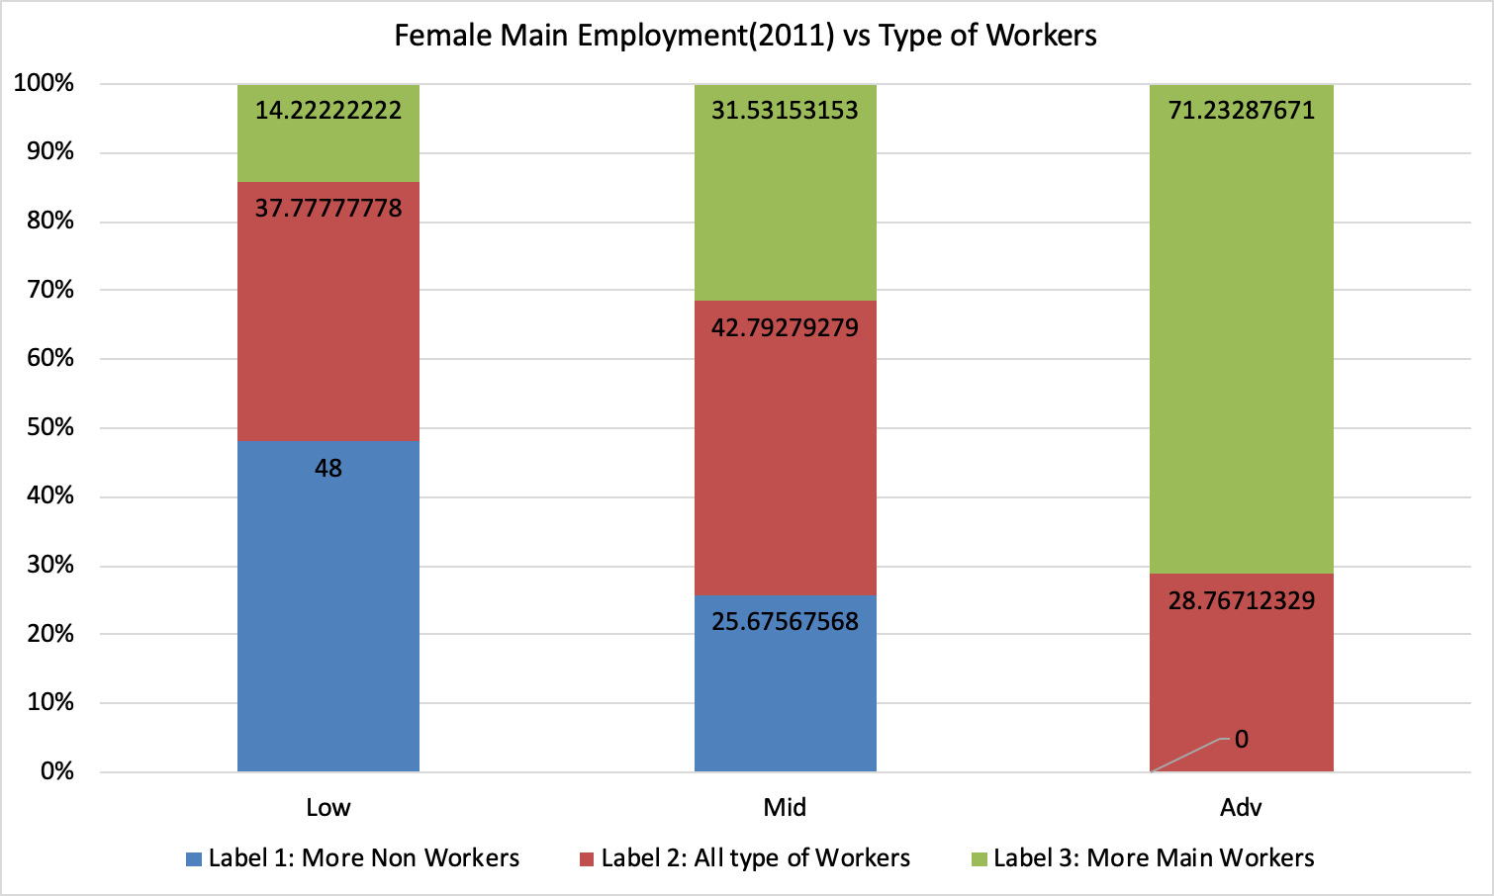
Hypothesis 11: Districts with higher levels of Female Main Employment have higher incidence of main-worker migrants
The Pearson’s coefficient of correlation between the FEMP of district and literacy of inbound migrants = 0.706834387
This can be considered as a High correlation

Slide 57
2D Analysis with Industry Type

Slide 58
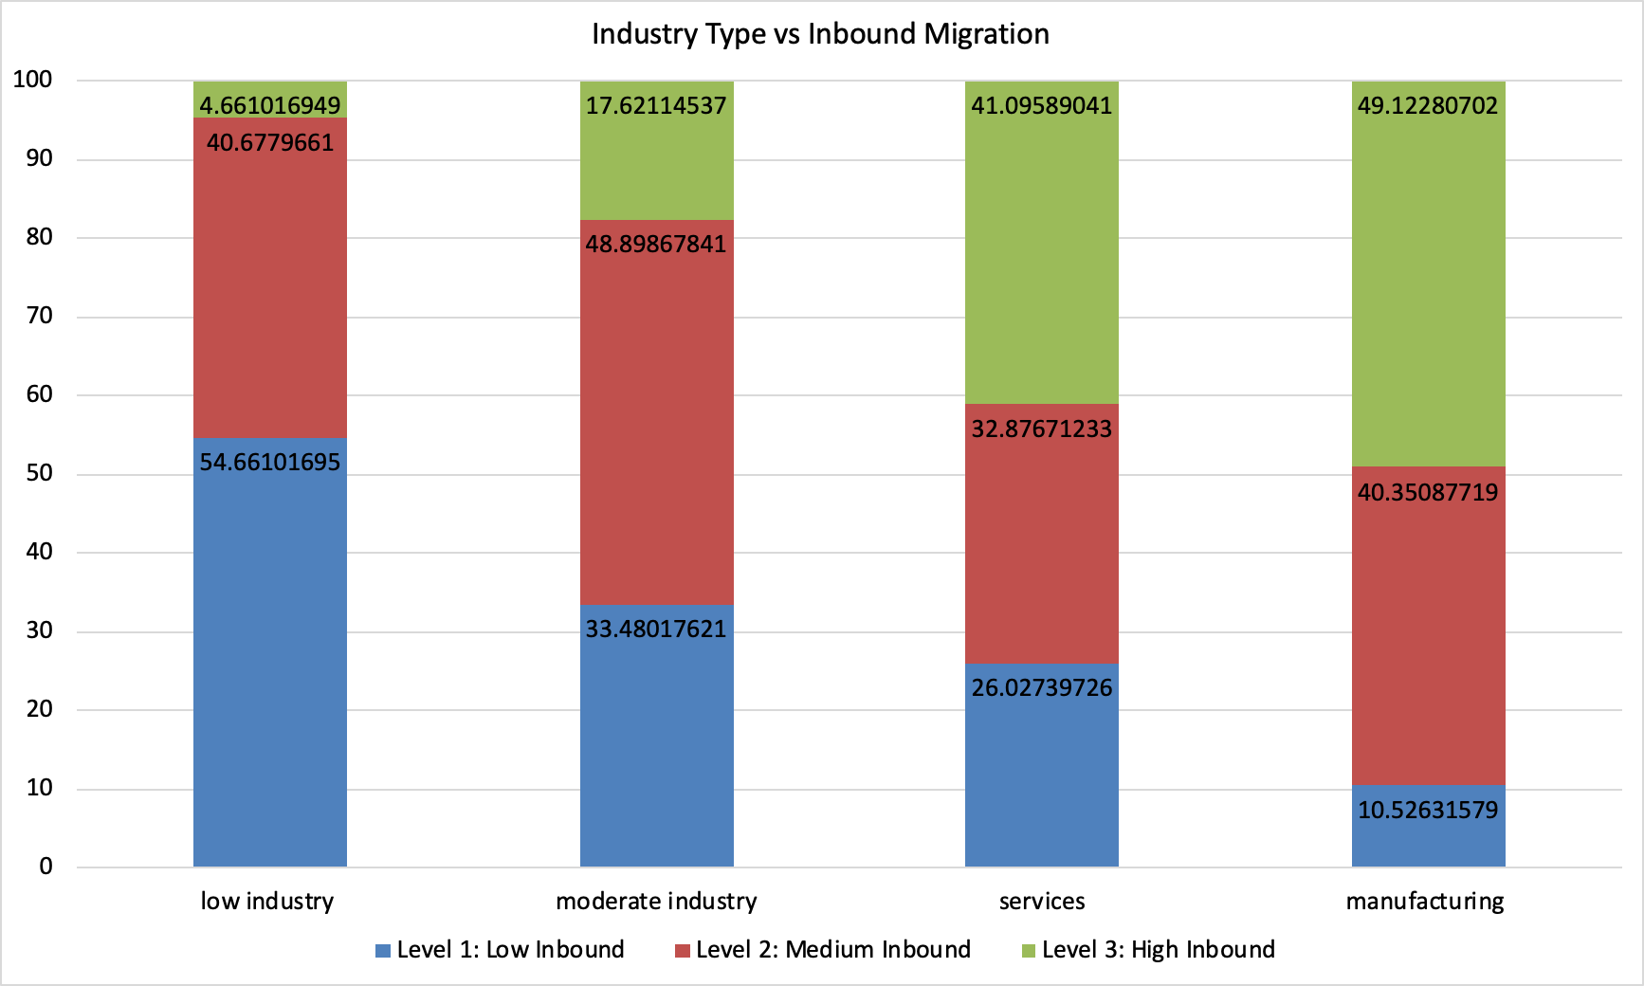
→ Districts with more industrial opportunities have higher incidence of inbound migrants
→ Districts with manufacturing and services-type industries have higher incidence of inbound migrants

Slide 59
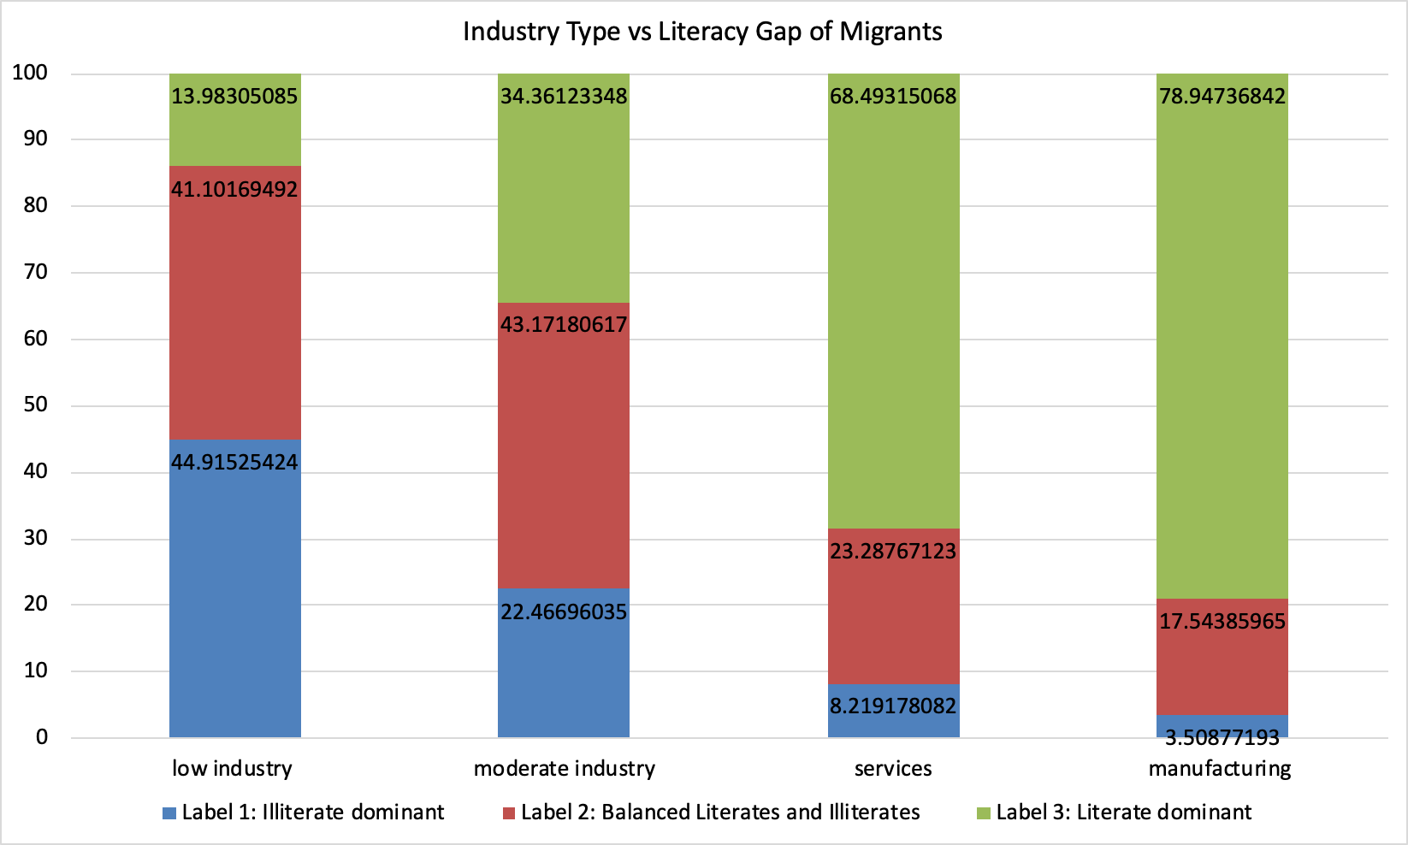
→ Districts with manufacturing and services-type industries have higher incidence of literate inbound migrants

Slide 60
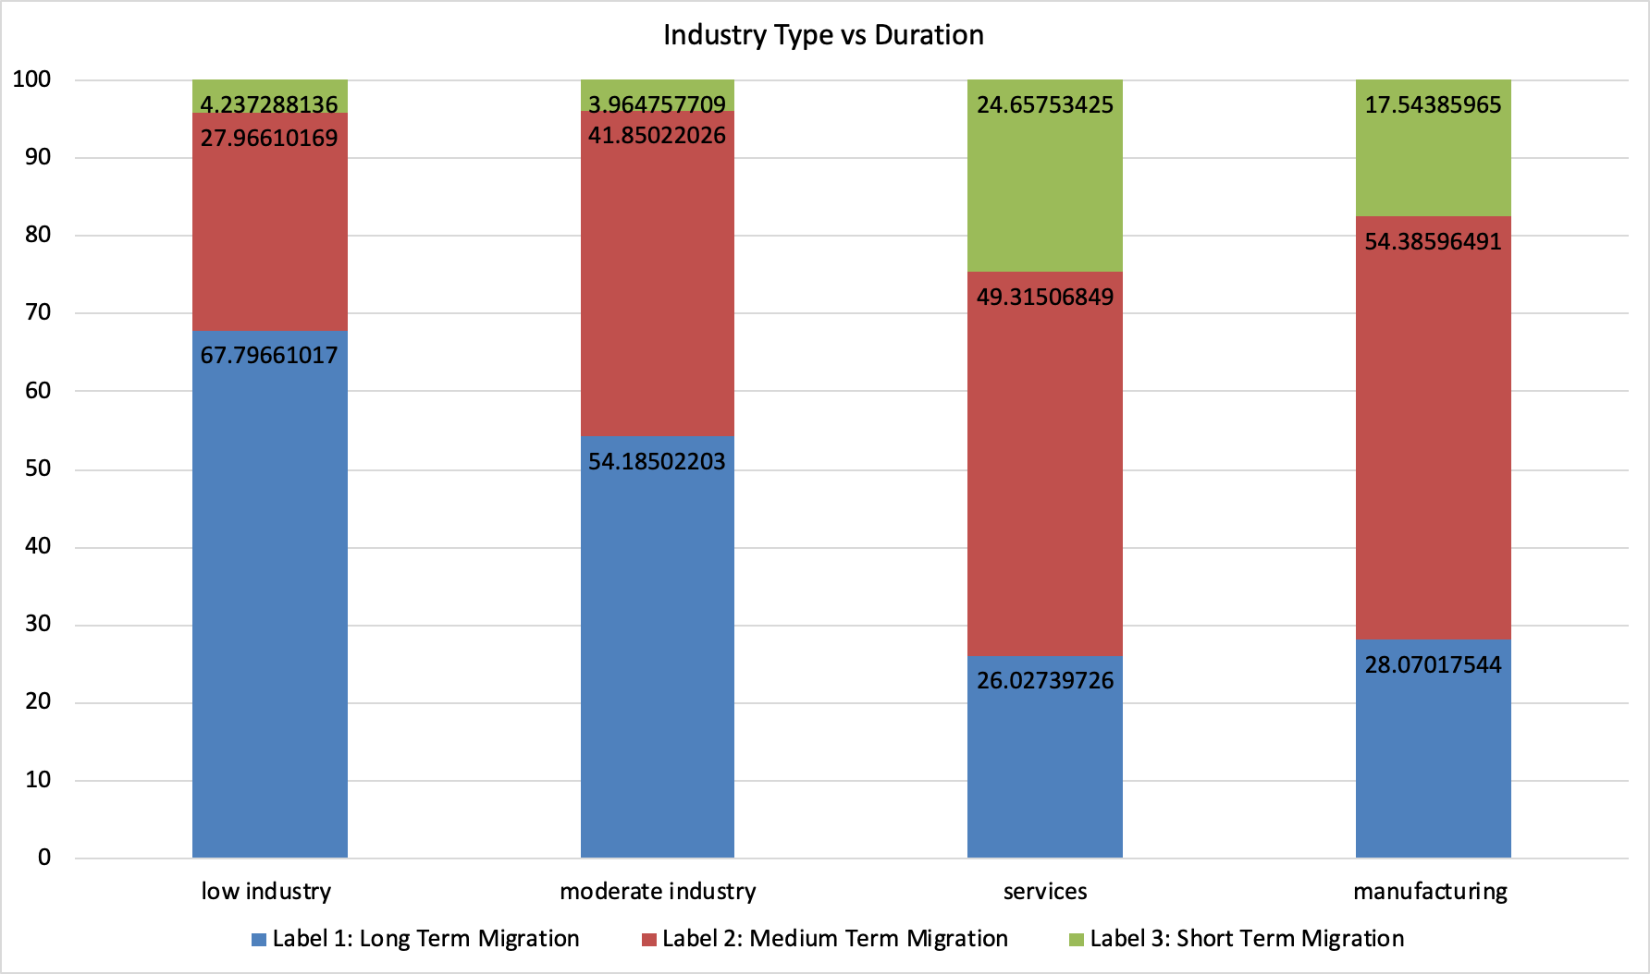
→ Districts with manufacturing and services-type industries have higher incidence of short-term migrants

Slide 61
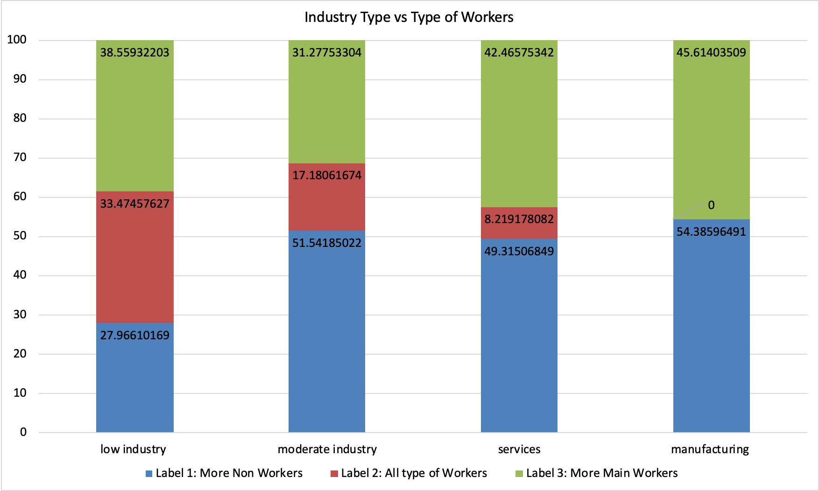
→ Districts with better industrial opportunities have higher incidence of main workers.

Slide 62
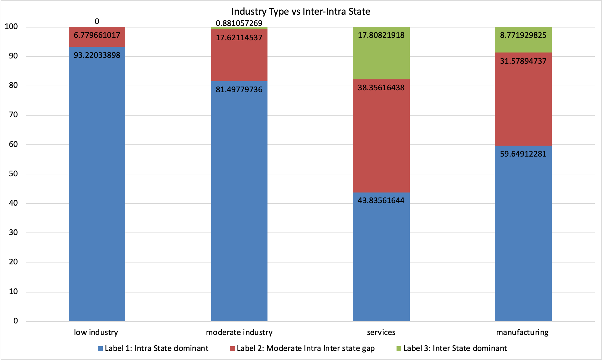
→ Districts with manufacturing and services-type industries have higher incidence of inter-state migrants.
→ Districts with services-type industries attract inter-state migrants the most.

Slide 63
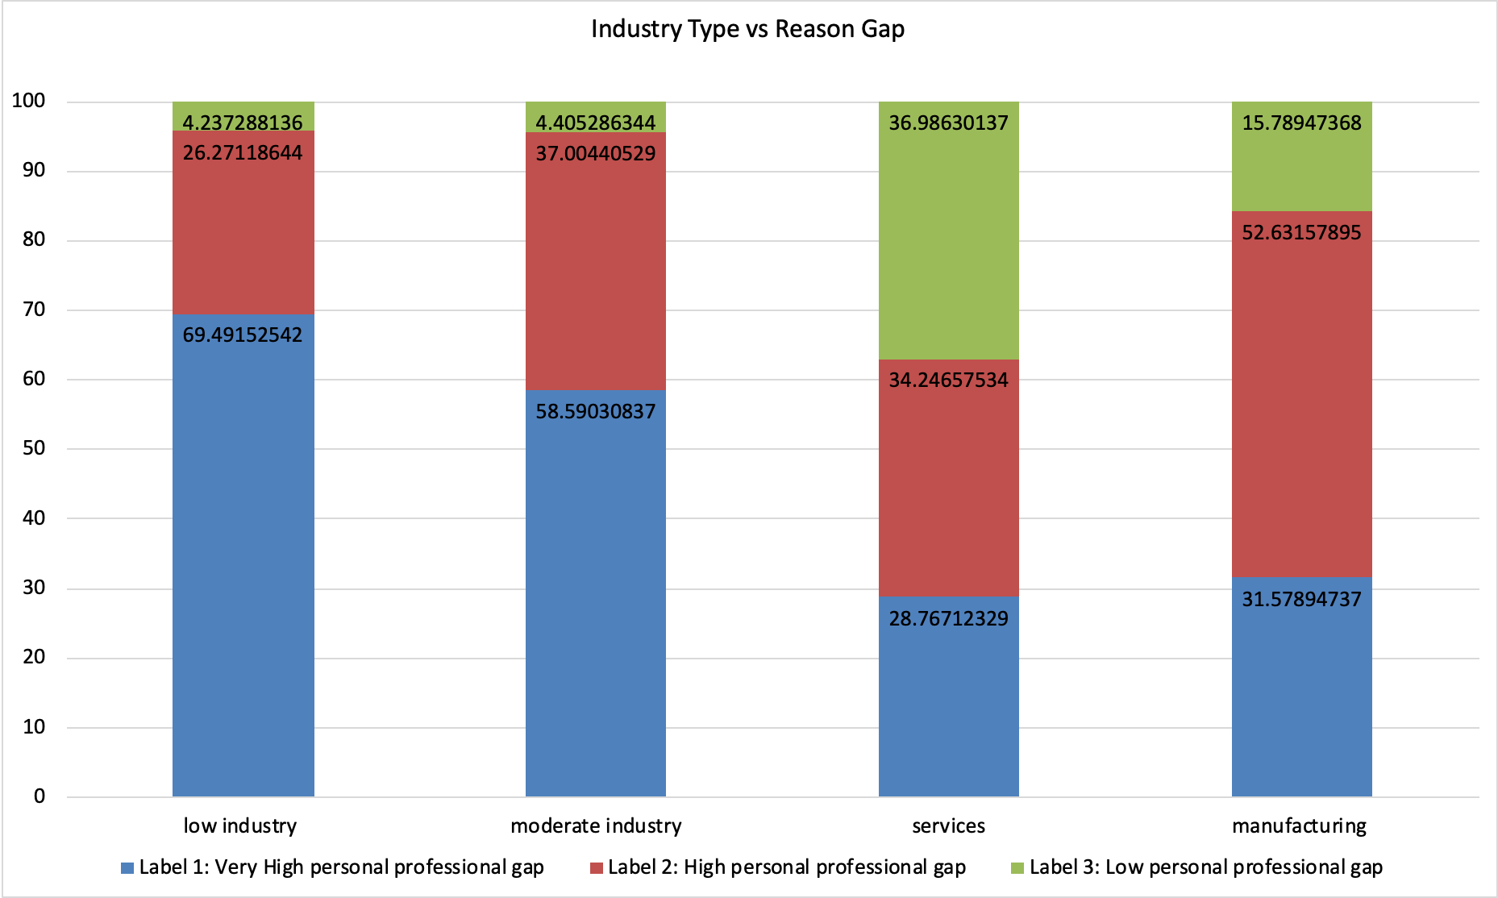
→ Districts with services-type industries have higher incidence of people migrating for both personal and professional reasons.

Slide 64
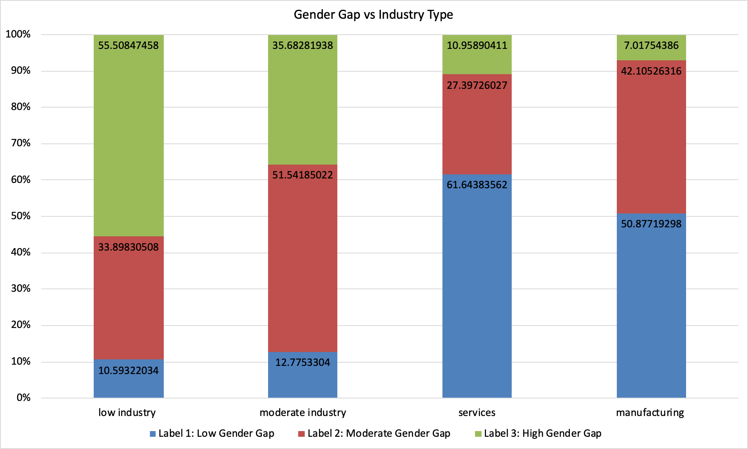
→ Districts with services-type industries have low gender gap
→ Districts with low industries have high gender gap

Slide 65
COMPARISON BETWEEN MALE-FEMALE INBOUND MIGRATION

Slide 66
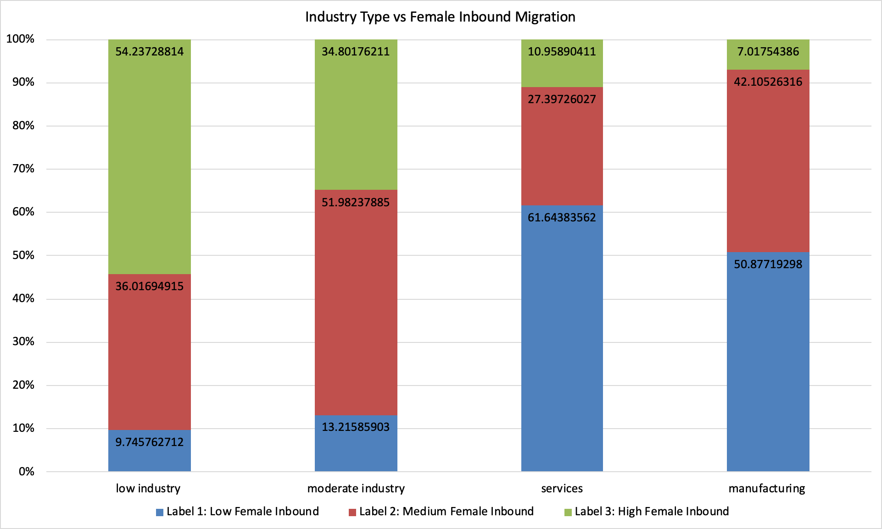

INBOUND MIGRATION VS INDUSTRY TYPE
MALE
FEMALE
→ Districts with manufacturing and service industries see high inbounds of male migrants
→ Districts with low and moderate industries see high inbounds of female migrants

Slide 67


INBOUND MIGRATION VS TYPE OF DISTRICT
MALE
FEMALE
→ Non agricultural districts see high inbounds of male migrants
→ Unemployment type districts see high inbounds of female migrants

Slide 68


INBOUND MIGRATION VS ADI
MALE
FEMALE
→ Districts with high ADI values see high inbounds of male migrants
→ Districts with low ADI values see high inbounds of female migrants

Slide 69
EMPLOYMENT ACTIVITY OF MIGRANTS

Slide 70

FEMALE MIGRANTS TYPE OF WORKERS- CLUSTERING
Size of Cluster
320
153
167

Slide 71

Female migrant's employment type vs industry type

Slide 72
State-level Analysis
For state-level also, we cluster the states and UTs on all migration variables to assign labels to them.

Slide 73
State level migrations tables were available for 2011 and 2001 as well
We have used State level Migration Data of 2011 and 2001.
Data from both the years had the same labels
We have performed clustering on the 8 labels discussed in slide 3-9
We got the same clusters as we did on District level 2011 data
Hence, our labels (1/2/3) remain the same

Slide 74
Change Analysis from 2001 to 2011 (State-wise + UT)

Slide 75

STATE- DURATION LABEL
There are 3 labels of states based on the number of years migrants migrate-
Label1 - Short Term Migration (1-5 years)
Label2- Medium Term Migration (5-20 years)
Label3- Long Term Migration (20+ years)
 | +ve change | Long Term→ Medium Term Long Term→ Short Term Medium Term→ Short Term
 | -ve change | Medium Term→ Long Term Short Term→ Long Term Short Term→ Medium Term
 | No change | No change in duration of migration of migrants
The duration for which people migrate within India, has decreased from 2001 to 2011 particularly in the southern parts of India.

Slide 76

STATE- TYPE OF WORKERS LABEL
There are 3 labels of states based on the types of workers which migrate there-
Label1 - Non-workers (Do not work)
Label2- Marginal workers
Label3- Main workers
 | +ve change | non-worker -> marginal non-worker -> main Marginal -> main
 | -ve change | marginal -> non-worker main -> Non-worker main -> Marginal
 | No change | No change in type of migrant workers
States with +ve Change - Delhi, Himachal Pradesh, West Bengal, Jharkhand, Arunachal Pradesh
States with -ve Change - Kerala, Goa, Orissa

Slide 77

STATE- INBOUND MIGRATION
There are 3 labels of states based on the types of workers which migrate there-
Label1 - Low Inbound
Label2- Medium Inbound
Label3- High Inbound
 | +ve change | Low Inbound→ Medium Inbound Low Inbound→ High Inbound Medium Inbound→ High Inbound
 | -ve change | Medium Inbound→ Low Inbound High Inbound→ Low Inbound High Inbound→ Medium Inbound
 | No change | No change in inbound type of migrant
States with +ve Change in Inbound Migration - Kerala, Tamil Nadu, Himachal Pradesh

Slide 78

STATE- GENDER GAP
There are 3 labels of states based on the types of workers which migrate there-
Label1 - Highly Female Dominant
Label2- Moderately Male Dominant
Label3- Moderately Female Dominant
 | +ve change | Highly Female Dominant→ Moderately Male Dominant Highly Female Dominant→ Moderately Female Dominant Moderately Male Dominant→ Moderately Female Dominant
 | -ve change | Moderately Male Dominant→ Highly Female Dominant Moderately Female Dominant→ Highly Female Dominant Moderately Female Dominant→ Moderately Male Dominant
 | No change | No change

Slide 79

STATE- LITERACY GAP
There are 3 labels of states based on the types of workers which migrate there-
Label1 - Illiterate Dominant
Label2- Balanced literates and Illiterates
Label3- Literate Dominant
 | +ve change | Illiterate Dominant→ Balanced literates & Illiterates Illiterate Dominant→ Literate Dominant Balanced literates & Illiterates→ Literate Dominant
 | -ve change | Balanced literates & Illiterates→ Illiterate Dominant Literate Dominant→ Illiterate Dominant Literate Dominant→ Balanced literates and Illiterates
 | No change | No change in literacy gap of migrants
Kerala and north eastern states have increased incidence of literate migrants since 2001
Northern India has seen an increase in illiterate migrants since 2001

Slide 80

STATE- INTRA/INTER STATE MIGRATION
There are 3 labels of states based on the types of workers which migrate there-
Label1 - Intra State Dominant
Label2- Lower Intra-Inter State Gap
Label3- Inter State Dominant
 | +ve change | Intra State Dominant→ Lower Intra-Inter State Gap Intra State Dominant→ Inter State Dominant Lower Intra-Inter State Gap→ Inter State Dominant
 | -ve change | Lower Intra-Inter State Gap→ Intra State Dominant Inter State Dominant→ Intra State Dominant Inter State Dominant→ Lower Intra-Inter State Gap
 | No change | No change
Jharkhand is the state which had increased incidence of inter-state migrants between 2001 and 2011

Slide 81
Change in Inbound and Outbound migration at State and UT level

Slide 82


Slide 83
Top states & UTs with maximum increase in Inbound Migration (from 2001 - 2011)
Formula → [(Inbound_2011/2011_Population) - (Inbound_2001/2001_Population)] * 100
(Inbound_2001/2001_Population)
Sr.No. | State | % Increase
1 | KERALA | 0.853529742
2 | TAMIL NADU | 0.701607988
3 | MEGHALAYA | 0.558767185
4 | DADRA & NAGAR HAVELI | 0.543963336
5 | MANIPUR | 0.535823897
6 | ANDHRA PRADESH | 0.463894952
7 | NAGALAND | 0.450327884
8 | KARNATAKA | 0.378513695

Slide 84


Slide 85
Top states & UTs with maximum increase in Outbound Migration (from 2001 - 2011)
Formula → [(2011_Outbound_Migrants/2011_Population)-(2001_Outbound_Migrants/2001_Population)]*100
(2001_Outbound_Migrants/2001_Population)
Sr.No. | State | % Increase
1 | Chandigarh | 6.14276749
2 | Puducherry | 9.55381456
3 | Lakshadweep | 5.25936447
4 | Uttarakhand | 3.1123578
5 | Himachal Pradesh | 2.70816256
6 | Goa | 2.54782605
7 | Uttar Pradesh | 1.3064817
8 | Rajasthan | 1.63881232

Slide 86
Top states & UTs with maximum decrease in Outbound Migration
(from 2001 - 2011)
Formula → [(2011_Outbound_Migrants/2011_Population)-(2001_Outbound_Migrants/2001_Population)]*100
(2001_Outbound_Migrants/2001_Population)
Sr.No. | State | % Decrease
1 | Jharkhand | -0.7757665
2 | Chhattisgarh | -0.7420327
3 | Tamil Nadu | -0.6567535
4 | Mizoram | -0.591598
5 | Maharashtra | -0.5692244
6 | Gujarat | -0.5243877
7 | Nagaland | -0.4416085
8 | Andhra Pradesh | -0.4386745

Slide 87


Slide 88
Key Observations from the change in inbound and outbound migration
Delhi is the only state that has +ve change in Outbound but -ve change in Inbound
Most states have had -ve change in Outbound but +ve change in Inbound, i.e. Inbound migration in these states has increased but outbound migration has decreased. This can be an indication of urban sprawl.

Slide 89
Bar graphs of Inbound Migration vs other migration variables at district-level

Slide 90


Slide 91

An understanding about the type of migrant workers and incidence of migration

Slide 92
An understanding about the literacy of migrants and incidence of migration

Slide 93

An understanding about the reason gap of migrants and incidence of migration

Slide 94


